Slide 1
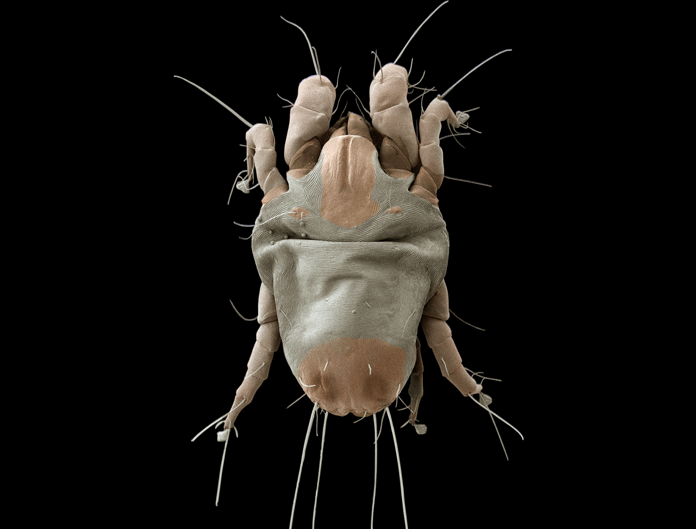
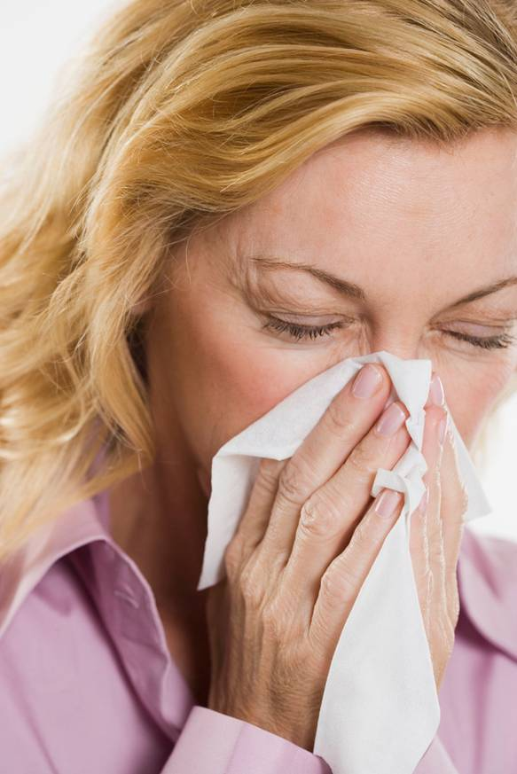
A shift from parasitism to the free-living lifestyle in early evolution of house dust mites
II Latin-American Congress of Acarology
Montenegro, Quindío, Colombia, May 29 2016
Pavel Klimov^{1,2}
¹ University of Michigan, Ann Arbor, MI, USA
² Tyumen State University, Tyumen, Russia

Slide 2
What are pyroglyphid house dust mites?
Medically important (yet understudied) family of arthropods.
There are other groups of mites occurring in dust but pyroglyphids are the most important
Feed on organic debris (eg., shed skin)
Live in houses and similar habitats (birds’ and mammals’ nests)
The most common cause of allergic symptoms in humans, affecting 65 million to 1.2 billion people worldwide.

Slide 3
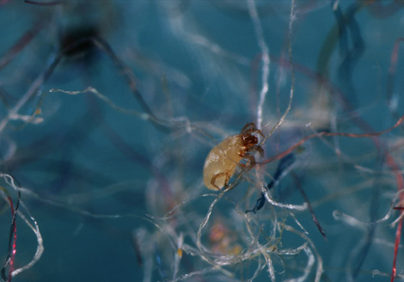
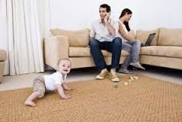

Occurrence
Found in abundance in sofas, carpets, bed mattresses, pillows and storage places.
HDM
Fiber

Slide 4
What are pyroglyphid house dust mites?
The mites’ severe allergenic properties are linked to their powerful digestive and molting enzymes, salivary secretions, and other water-soluble molecules.
Large quantities of digestive enzymes accumulate in mites’ fecal material – minute particles that can easily become airborne. When inhaled or in contact with skin, the residual mite enzymes may break up tight junctions between the epithelial cells and trigger allergic reactions

Slide 5
Pathogenicity
HDM are responsible for IgE mediated allergic diseases
Described as Type I hypersenstivity
Mite feaces, hemolymph, skin molts, exoskeleton and internal tissues contain proteins that cause allergies (Allergens) on contact or when inhaled.

Slide 6
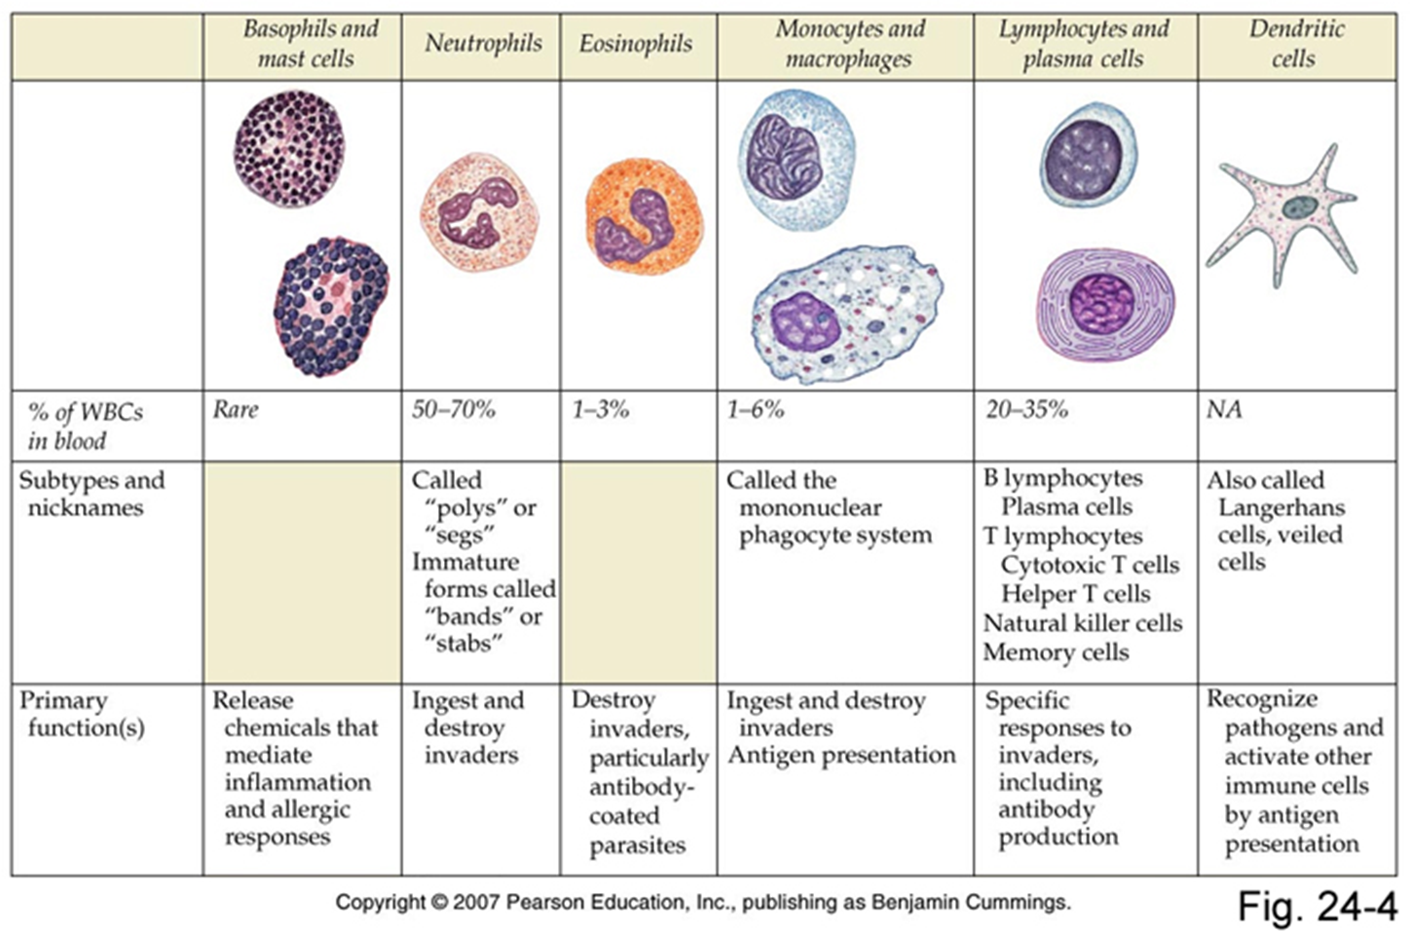

Cells of our immune system

Slide 7

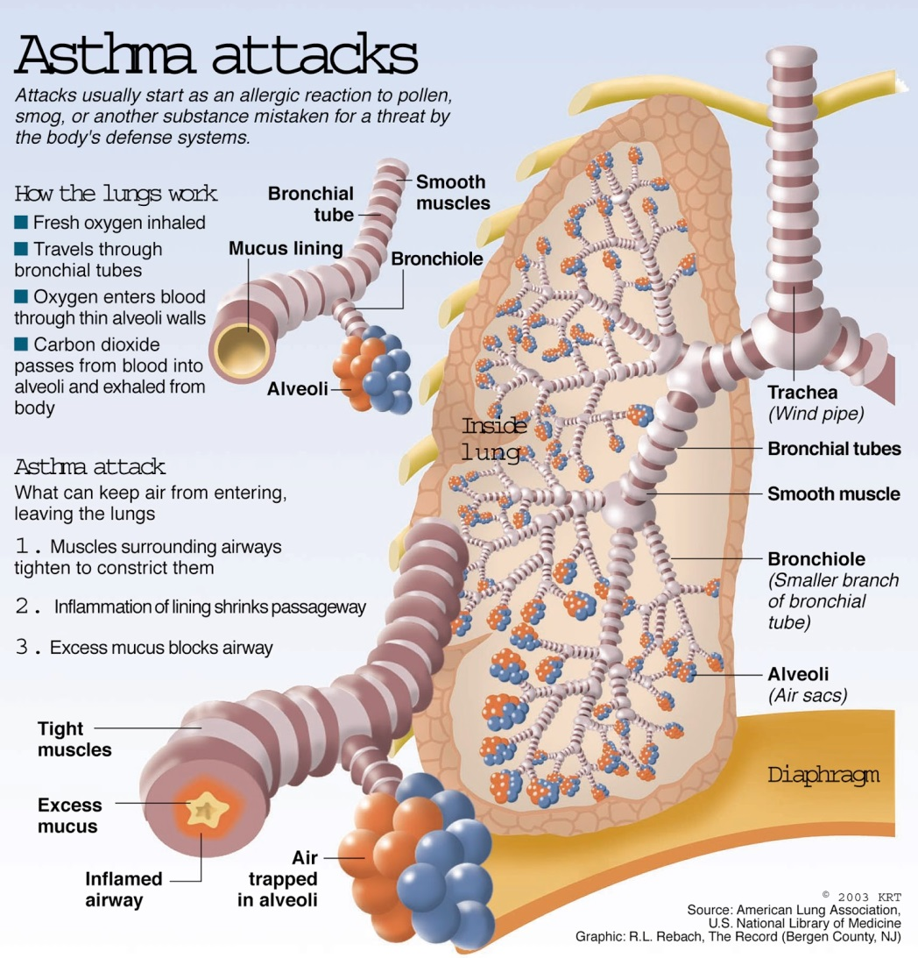
Asthma
( Arlian et al., 1992)

Slide 8
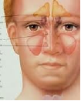

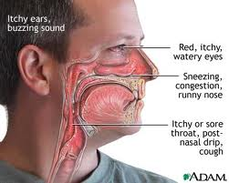

Slide 9

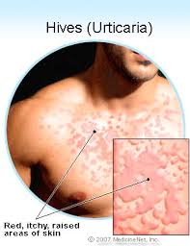
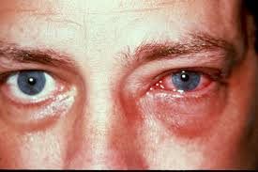


Slide 10
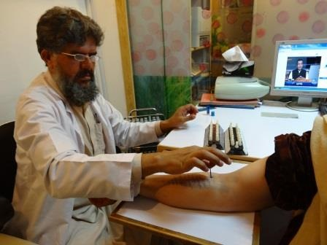
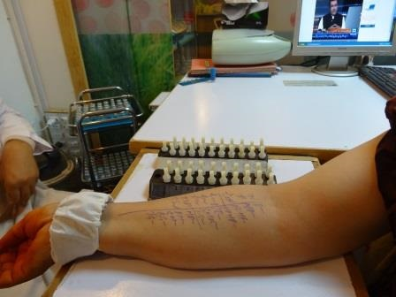
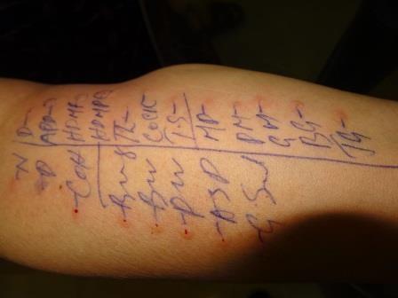
First the skin of the fore arm of the patient is cleaned with an alcohol swab
Names of the aero allergens to be tested written on the forearm
Drops of particular allergen placed against the name written and pricked with disposable a lancet

Slide 11
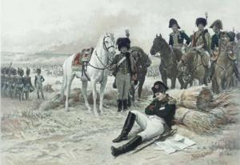
Diversity of acariform mites
(42,000+ spp in almost all habitats)
fur mites
House dust mites
Sir, our troops are surrounded by the enemy
Feather mites
For non-acarologists, I will mention chiggers, house dust mites, sarcoptic mange mites, gall mites, spider mites, etc
Demodectic mites
Eyelash mite
Sarcoptic mange
mite
chorioptic mange mite
chiggers
No, mites did it first!
Cheyletid mites
Gall mites
Straw itch mite
Spider mites
Stored product mites
wheat curl mite
False spider mites
winter grain mite
grain mites
oribatid (soil) mites
Cheese mite

Slide 12
Where pyroglyphids come from?
Pyroglyphid mites belong to a large acarine lineage, the Astigmata, comprising more than 6,100 described species. This lineage contains an ensemble of several mutually paraphyletic, mostly free-living lineages (‘free-living Astigmata’) and a large monophyletic parasitic lineage – Psoroptidia.
pyroglyphids ?
2,300 spp
3,800 spp
free-living 1*
free-living 2*
parasitic (Psoroptidia)
Astigmata (6,100 spp)

Slide 13
Brief Introduction to Astigmata
pyroglyphids ?
2,300 spp
3,800 spp
free-living 1*
free-living 2*
parasitic (Psoroptidia)
Astigmata (6,100 spp)

Slide 14
Brief Introduction to Astigmata free-living mites
2,300 spp
pyroglyphids ?
3,800 spp
free-living 1*
free-living 2*
parasitic (Psoroptidia)
Astigmata (6,100 spp)

Slide 15
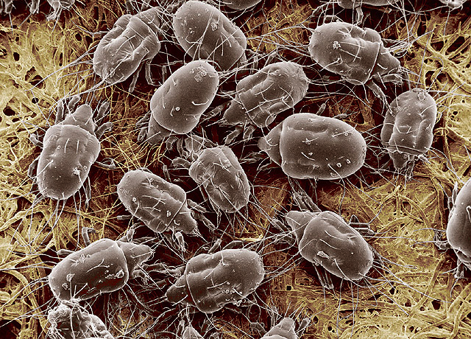
Astigmata: “storage mites”
Free-living Astigmata (ca. 2,300 species) are usually saprophagous, feeding on decaying organic material, fungi, and bacteria found in patchy or ephemeral habitats – fungal sporocarps, sap flows, dung, carrion, seaweeds, insect and vertebrate nests, and stored food (hence the colloquial name ‘storage mites’). Storage mites often develop large populations in dust and stored biological products (e.g. grain, straw), and can cause allergies in humans (Sidenius et al. 2001; Ong and Chew 2010). Specialized deutonymphs often disperse among habitat patches through phoretic associations with arthropods and vertebrates that also use these resources. Phoretic deutonymphs usually do not feed during dispersal, but there are several unrelated free-living lineages with parasitic deutonymphs: Hypoderatidae, Glycyphagidae, Chortoglyphidae, and Echimyopodidae (Fig. 1, color-coded yellow). These deutonymphs occur inside hair follicles or under the skin, where they acquire nutrition from hosts (the exact mechanism is still not understood – these deutonymphs do not have a mouth or normal gut).

Slide 16
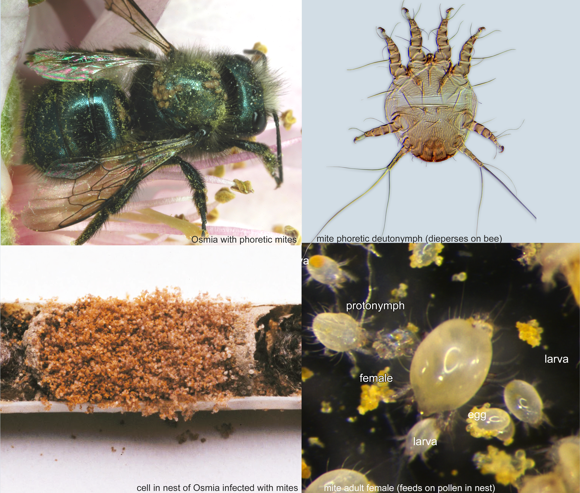
kleptoparasitic Astigmata

Slide 17
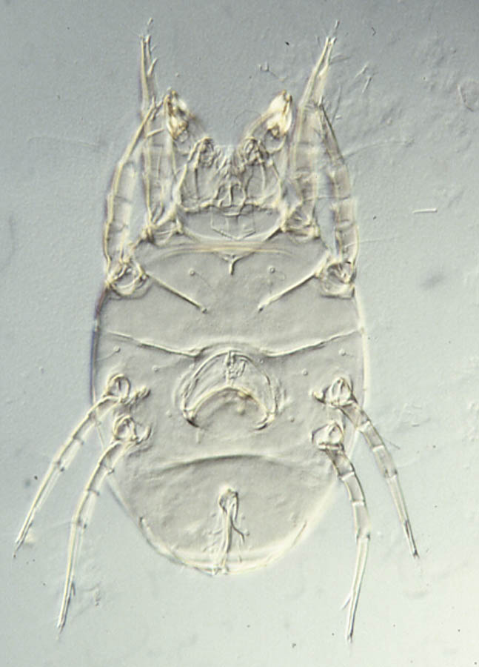
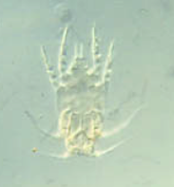
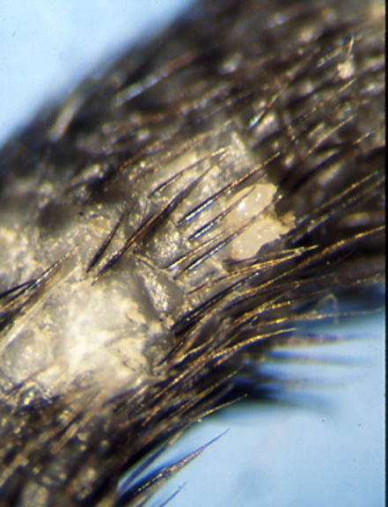
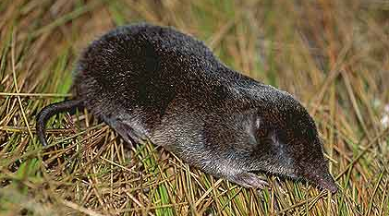
Family Chortoglyphidae
Adults are free-living
Deutonymphs are parasitic
Alabidopus n. sp.
Chortoglyphus
arcuatus

Slide 18
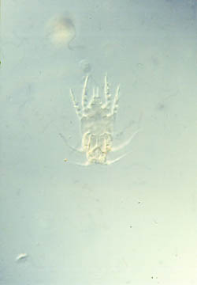
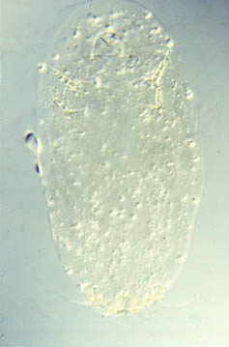
Unusual “feeding” by deutonymphs
not engorged
engorged
Alabidopus n. sp. deutonymph (Chortoglyphidae)

Slide 19
Brief Introduction to Astigmata parasitic mites (Psoroptidia)
2,300 spp
pyroglyphids ?
3,800 spp
free-living 1*
free-living 2*
parasitic (Psoroptidia)
Astigmata (6,100 spp)

Slide 20
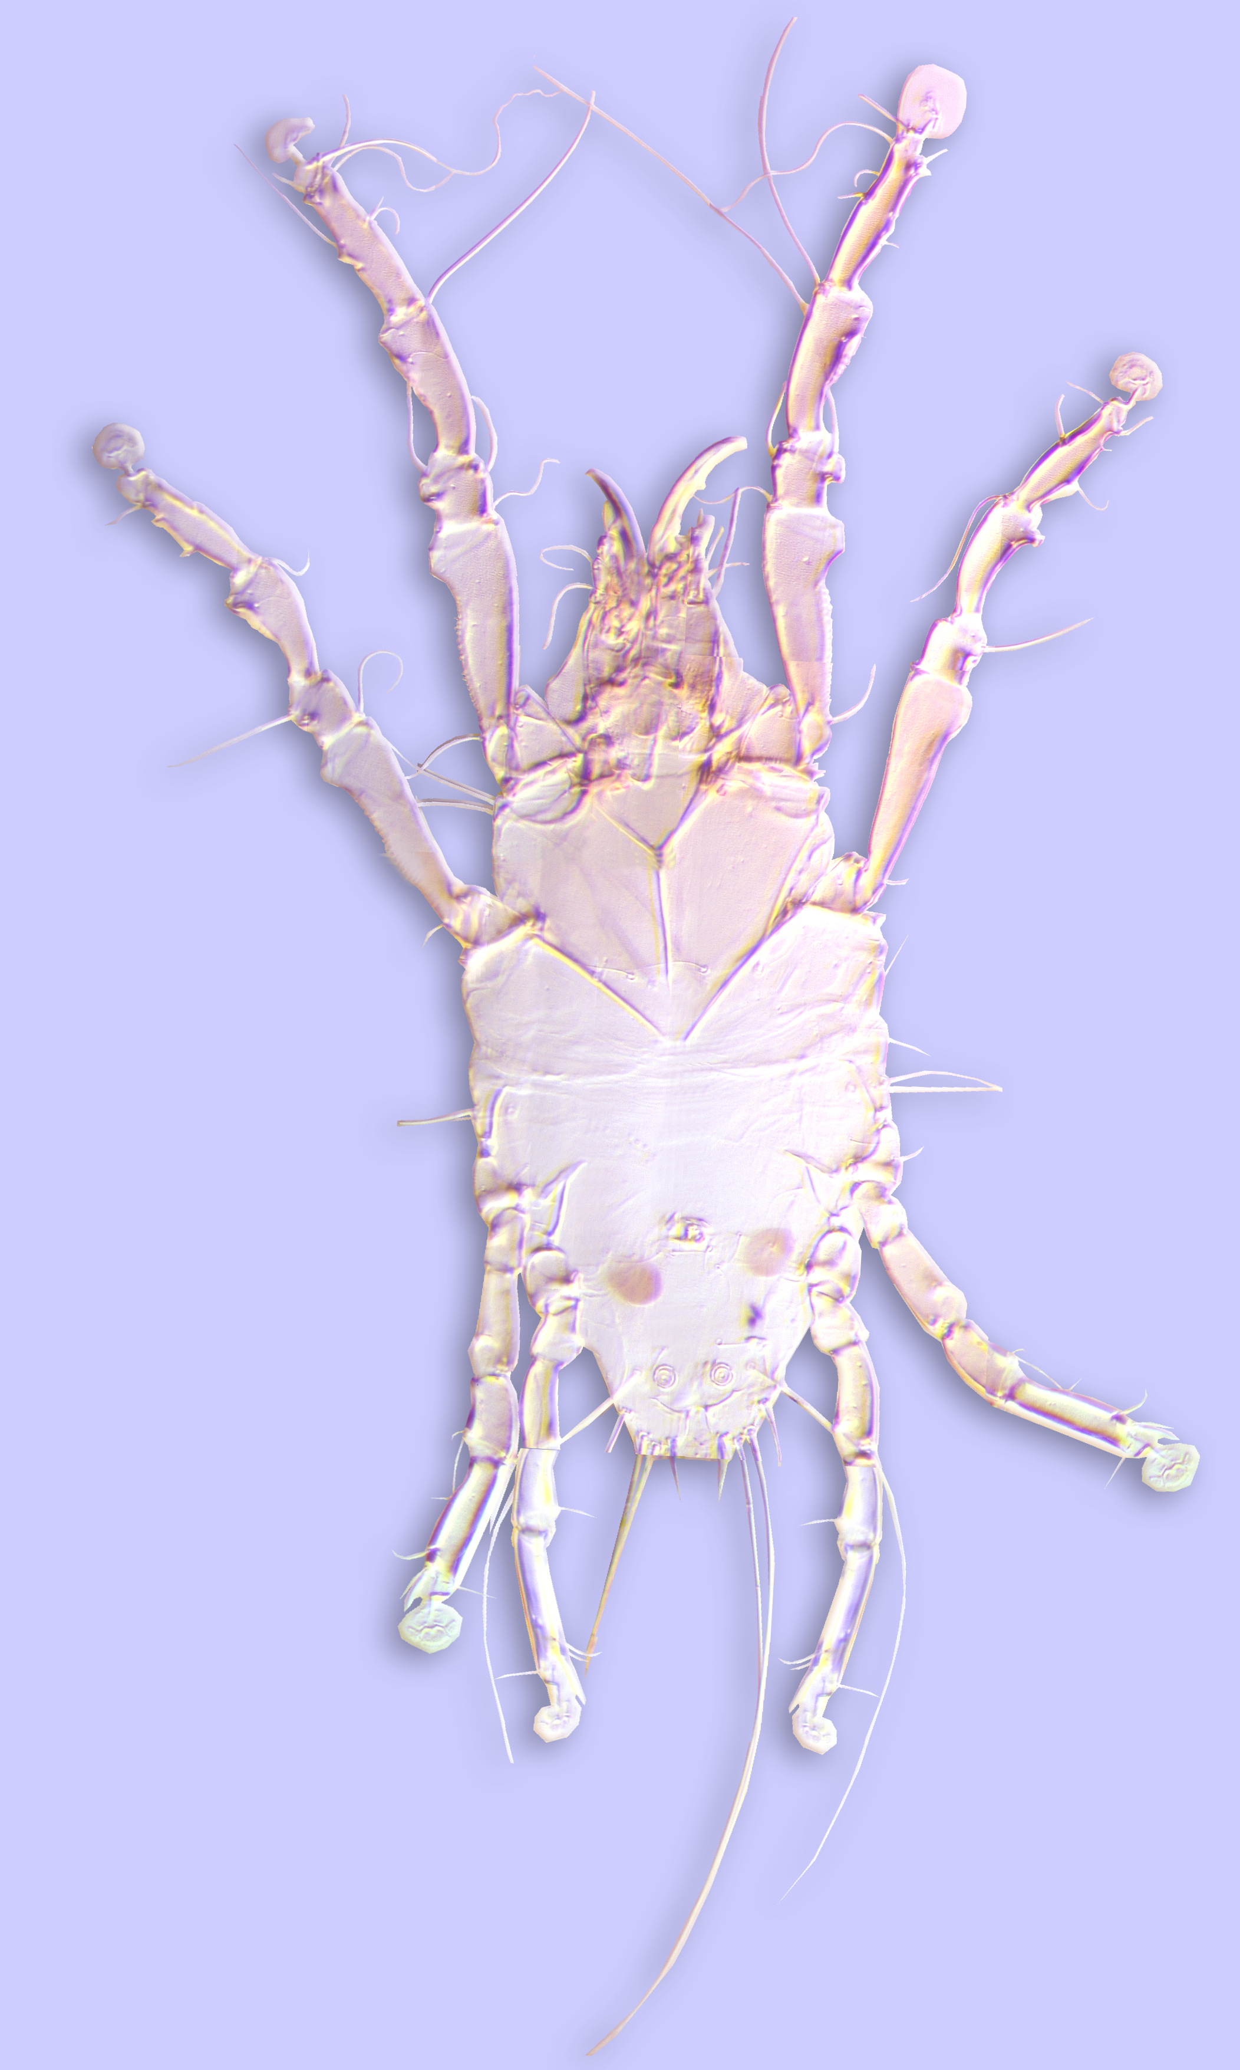

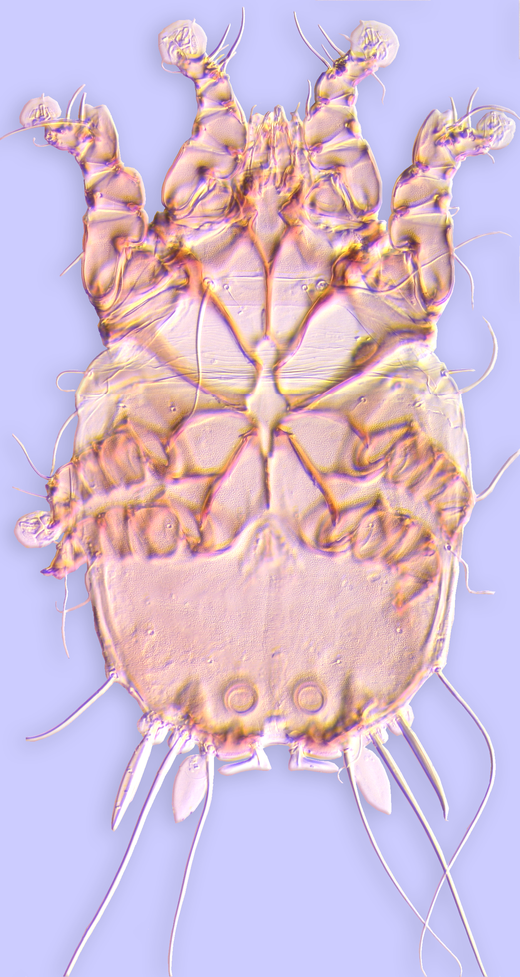
Feather mites: subfamily Pterolichoidea
Feather mites are grouped into two subfamilies: Pterolichoidea and Analgoidea
With a few exceptions, pterlichoids occur on non-passeriform birds, with the majority of families (14) inhabiting feather vanes (e.g., Freyanidae, Falculiferidae), while 4 other families live in the quills of the wing and tail feathers.
Freyana (Freyanidae)
Faculiferidae

Slide 21
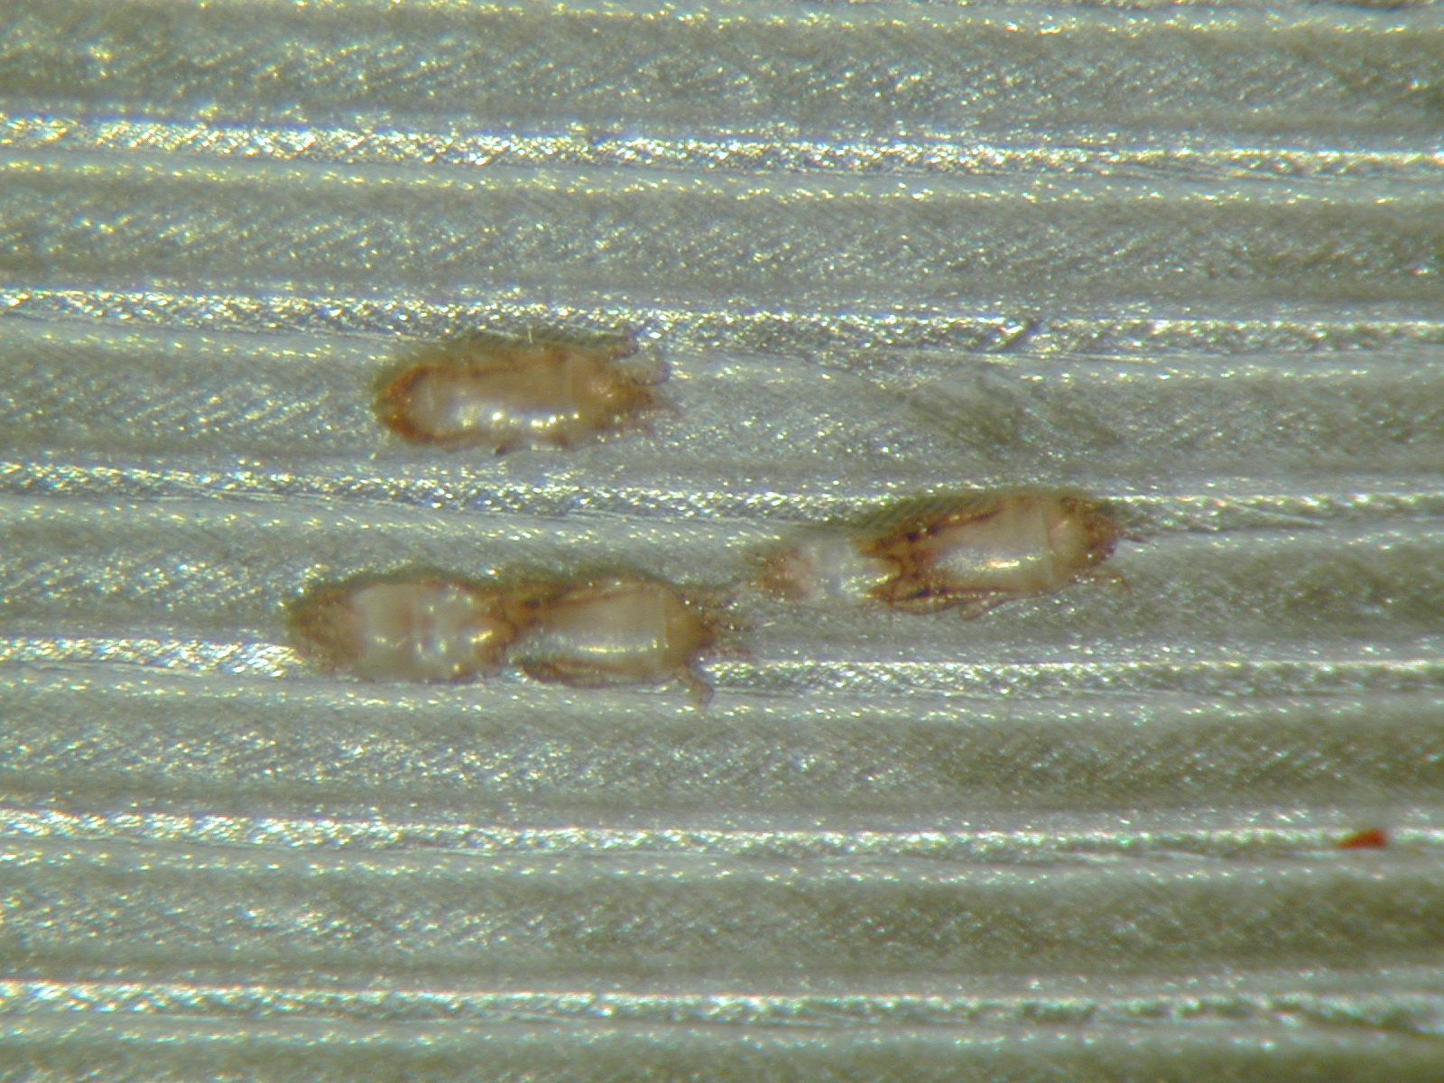
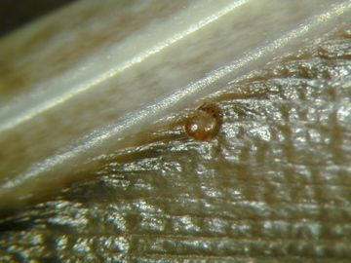
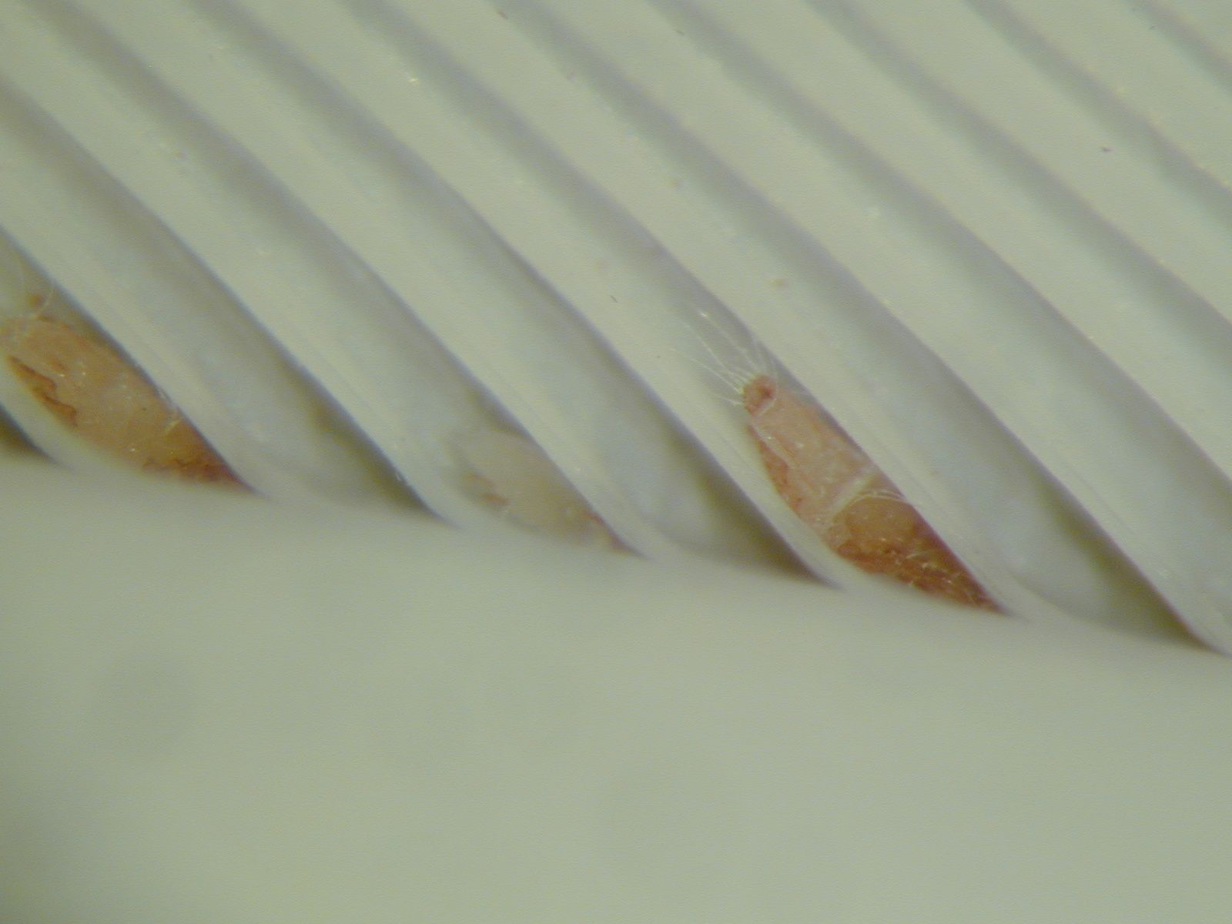
The superfamily Pterolichoidea
18 families
Ptiloxenus major (Ptiloxenidae) from grebe
Freyana sp.
(Freyanidae) from common merganser
Falculifer rostratus
(Falculiferidae) from domestic pigeon
Notes:
21

Slide 22
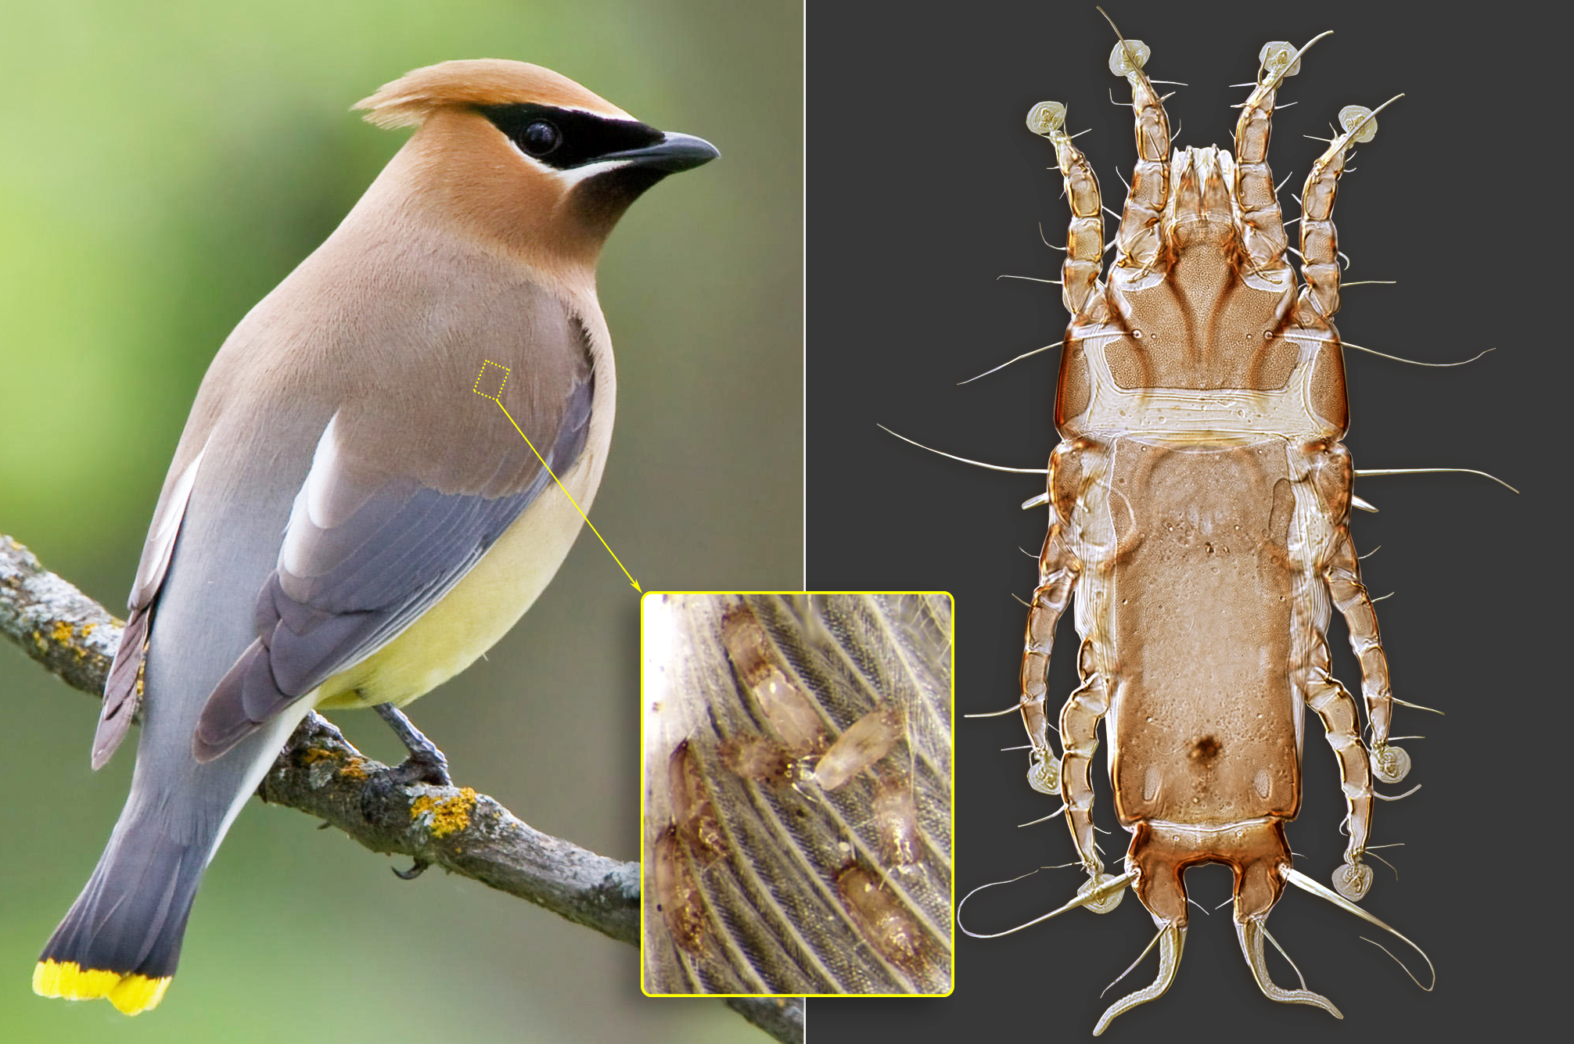
Analgoidea living on feather vanes
female
Proctophyllodes ampelidis on bird Bombycilla cedrorum

Slide 23
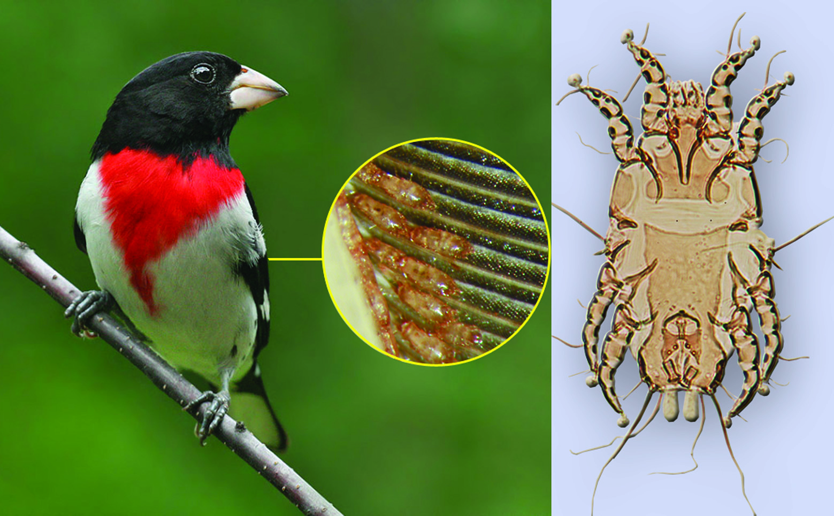
Feather mites living on feather vanes
Feather mites can be found on the plumage of virtually every bird. Sometimes there are several species in different areas of the host body. Many feather mites exhibit strict coevolution with their hosts.
.
Proctophyllodes pheuctici
(Proctophyllodidae)
Pheucticus ludovicianus

Slide 24
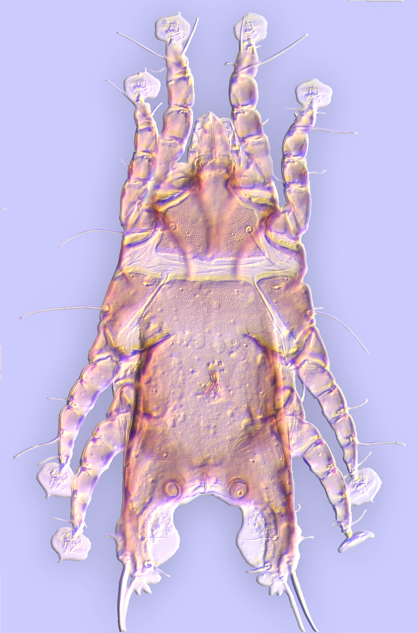
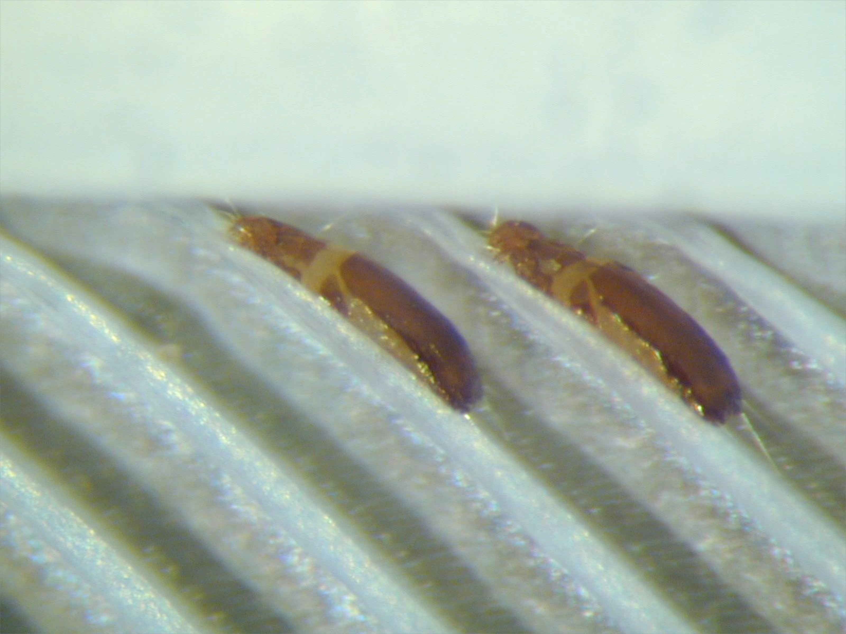
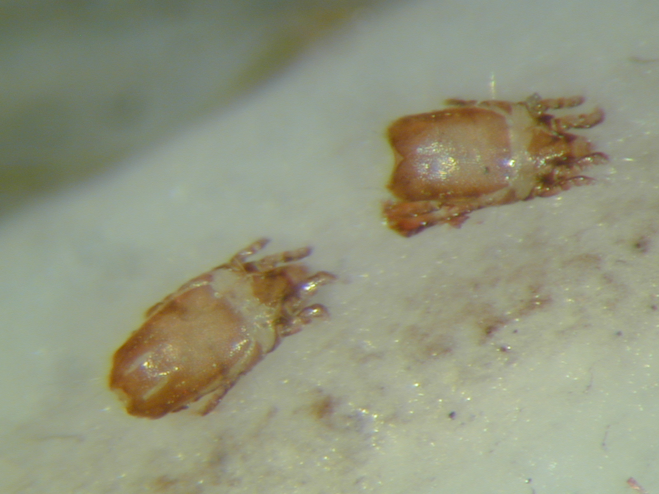
Analgoidea living on feather vanes
Family Avenzoariidae
Early derivative analgoid lineage.
Diverse on aquatic bird orders.
Ambulacral disc narrowed apically like “ace of spades”.
Avenzoaria calidridis
(Avenzoariidae) from least sandpiper.
Avenozoaria
(Avenzoariidae)
Bychovskiata squatarolae
(Avenzoariidae)
from plover
Notes:
24

Slide 25
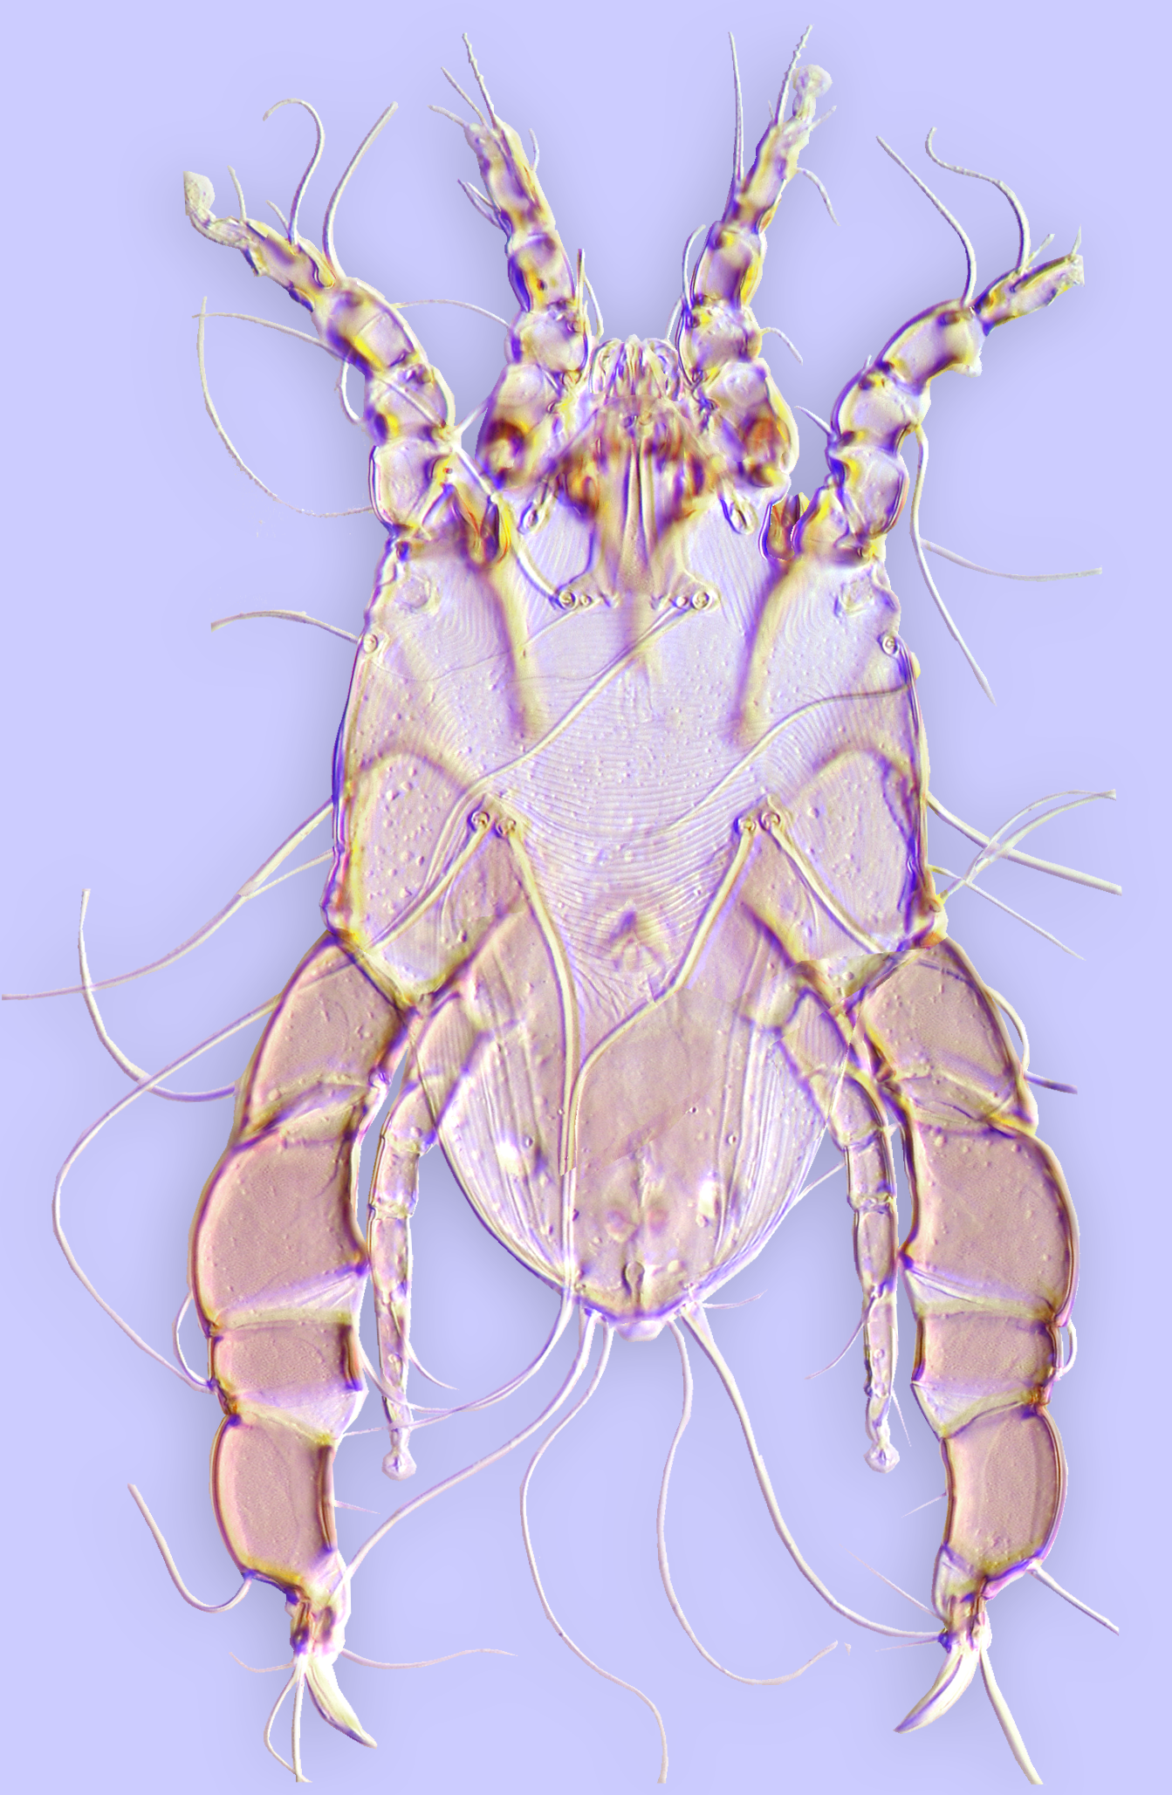
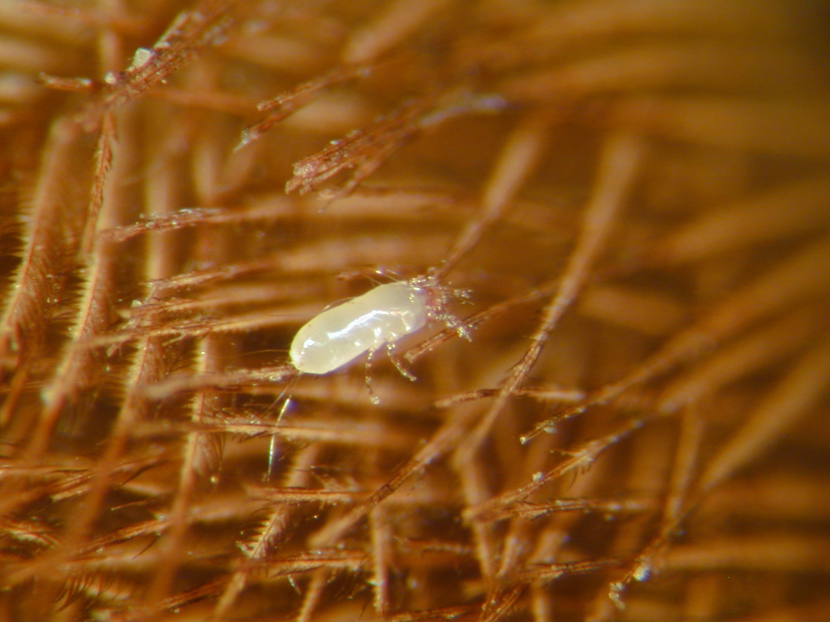
Analgoidea living on plumaceous feathers
family Analgidae
Diverse on many bird orders.
Ambulacral stalk originates ventrally.
Spines or membranes on anterior
tibiae. Males often with continuous,
size-related polymorphism
Analges (Analgidae)
Analges sp. female from waxwing
Notes:
25

Slide 26
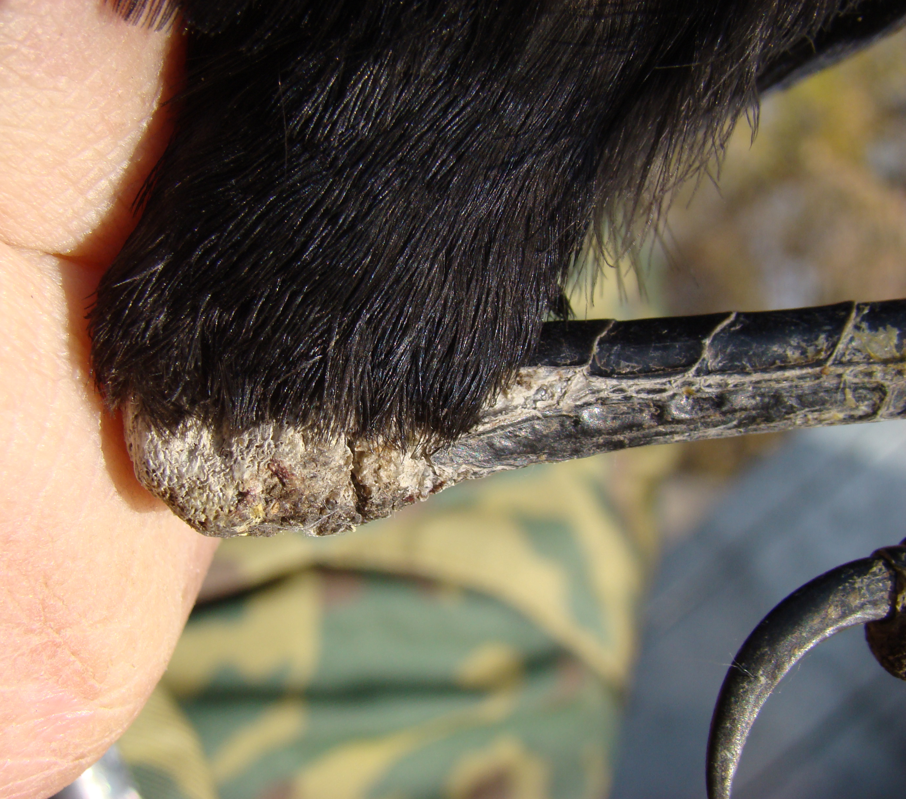
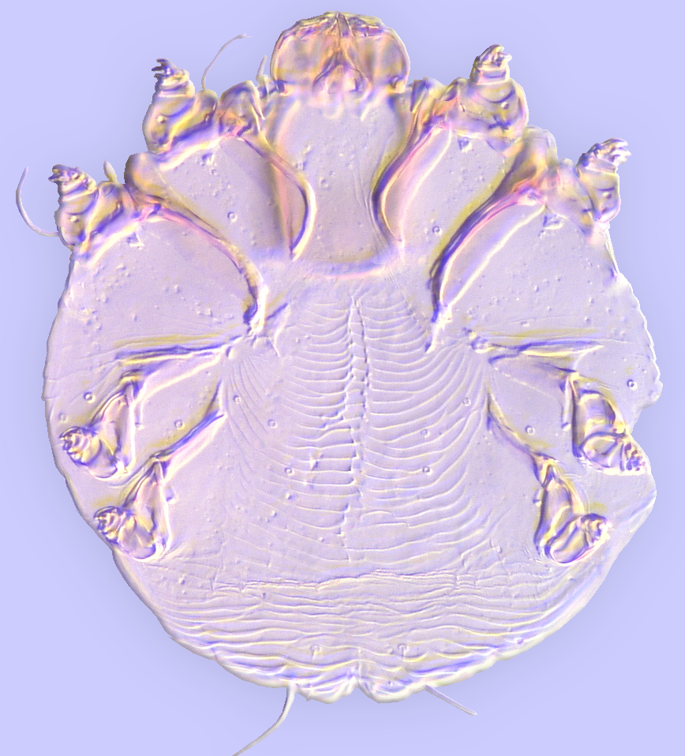
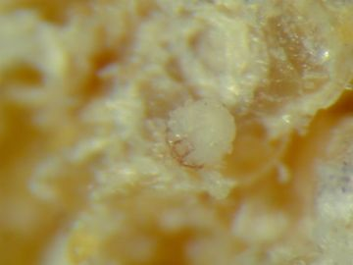
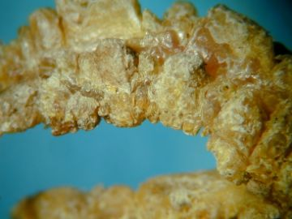
Analgoidea living on skin and in the feather follicles
Species of Knemidocoptinae live in subcutaneous tissue, displaying ecological paralellism with Sarcoptidae, the family of mammalian parasites.
.
damage
Knemidocoptes (Knemidocoptidae)
Knemidokoptes jamaicensis
from yellow warbler.

Slide 27
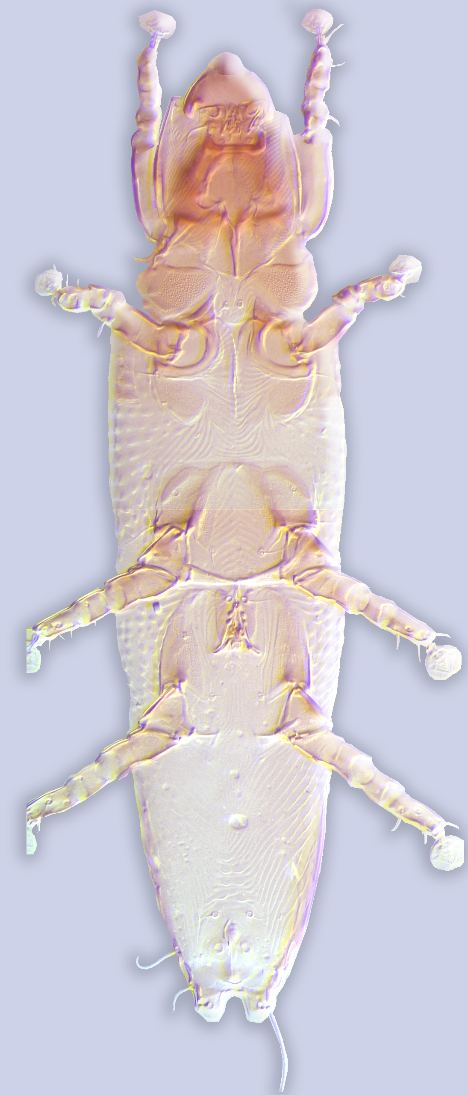
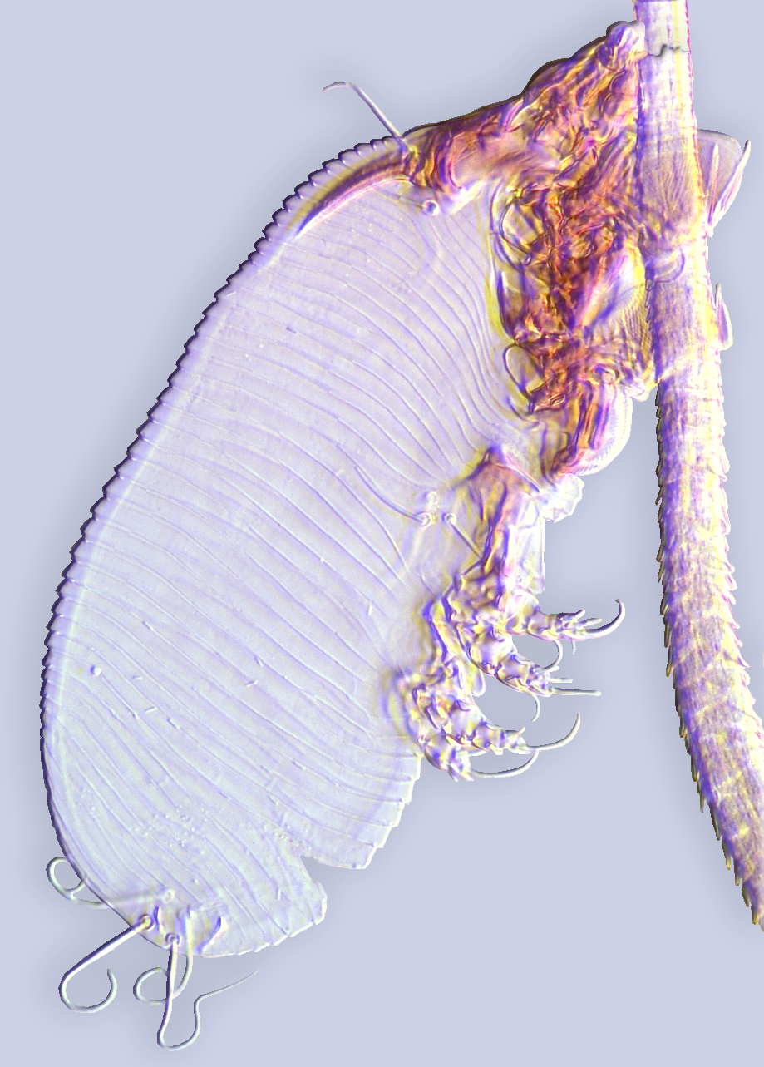
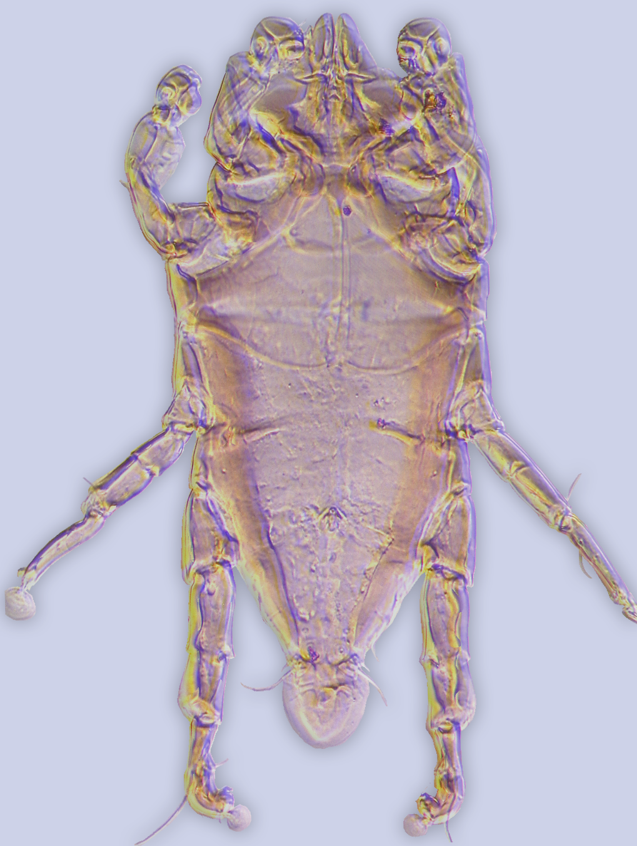
Labidocarpellus eonycteris
(Chirodiscidae)
Now am going to introduce you to some groups of Psoroptidia.
Chirodiscoides interruptus
(Atopomelidae)
Listrophorus squamiferus
(Listrophoridae)
Fur mites (families Listrophoridae, Atopomelidae, and Chirodiscidae) are presumably monophyletic, specialized for life on hair shafts feeding on sebaceous materials and generally causing no damage to the hair.

Slide 28
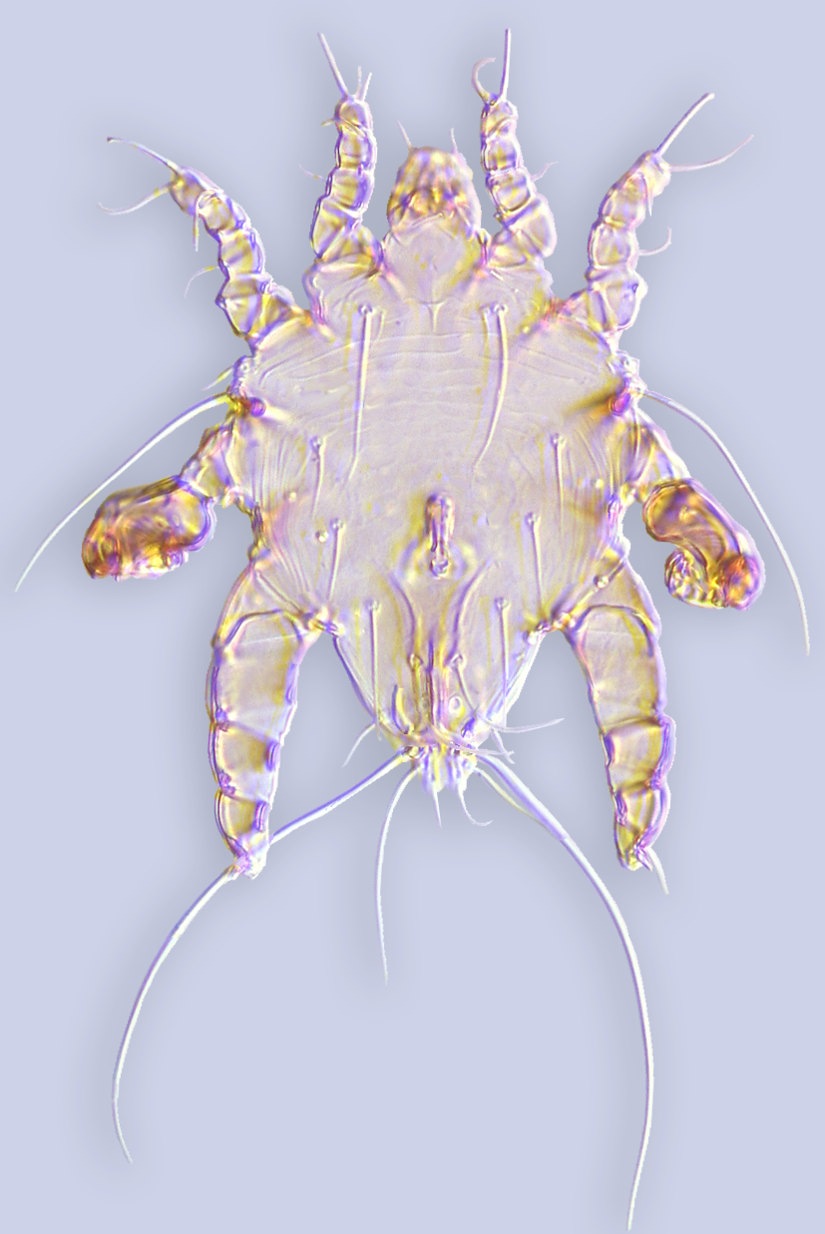
Myocoptes japonensis (Myocoptidae)
Similarly to the true “fur mites”, mites of the family Myocoptidae use legs for attaching to the host hair, and like psoroptids, they feed on tissue fluid from the skin. Probably, for these reasons, either “fur” mites or psoroptids were considered as relatives of Myocoptidae.

Slide 29
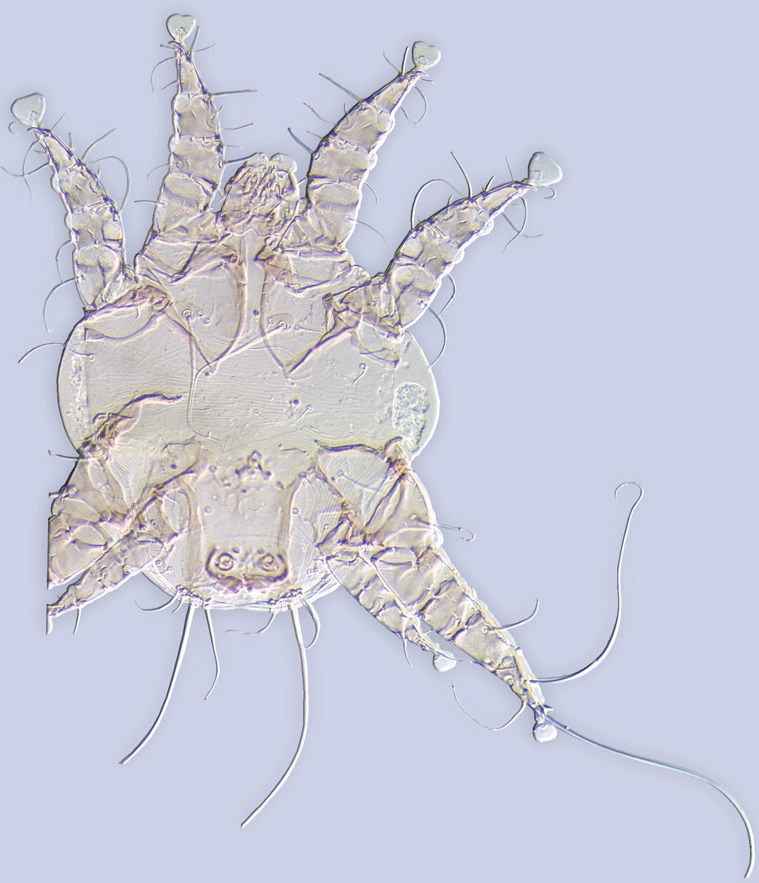
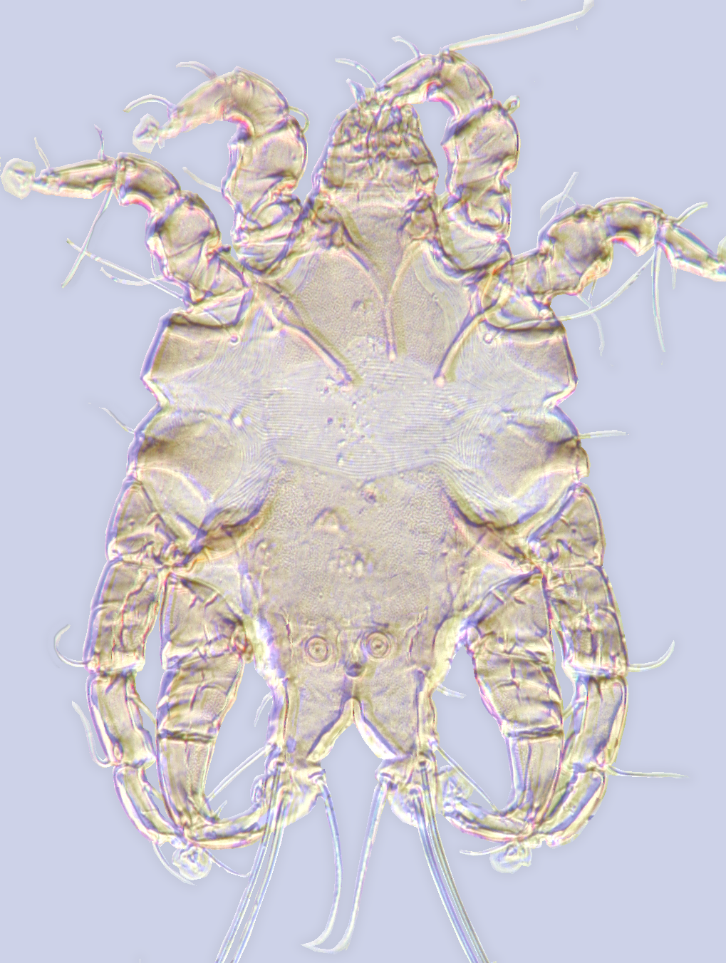
xxxx
Otodectes cynotis (Psoroptidae)
Lobalges trouessarti (Lobalgidae)
Other mites associated with mammals live on skin and feed by scraping the skin with their chelicerae and ingesting tissue fluid (e. g. Psoroptidae). The feeding habits of Lobalgidae are unknown, but its species were collected from fur of sloths and spiny hairs of echimyid rodents.

Slide 30
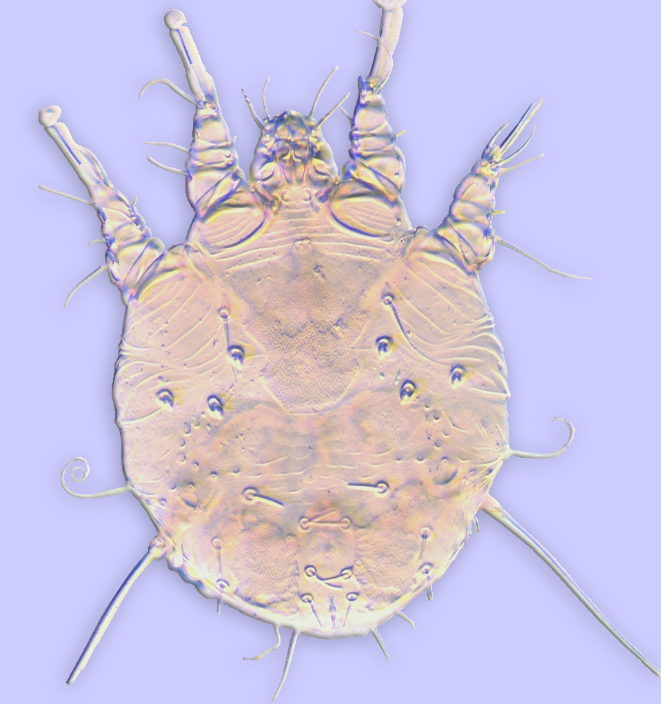
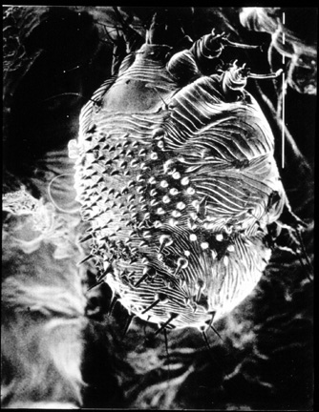
Sarcoptes scabiei (Sarcoptidae)
Sarcoptes scabiei (Sarcoptidae)
Species of two related families, Sarcoptidae and Rhyncoptidae, have adapted to live in the skin of mammals. Sarcoptes scabiei burrows in the upper epidermal layers of the human skin. This species has shifted from humans to domestic and, subsequently, to wild animals.

Slide 31
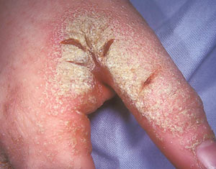
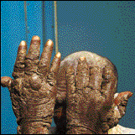
Parasitic mites
The human scbies mites burrow beneath the skin of their hosts and feed on subepidermal exudates. In humans this mite is relatively benign, but when it secondarily infects domesticated or wild animals it may disable or kill the host.
Sarcoptes scabiei (Sarcoptidae)
Sarcoptes scabiei (Sarcoptidae)

Slide 32
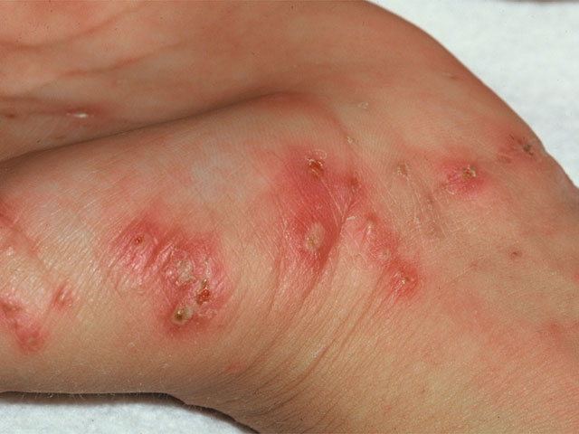
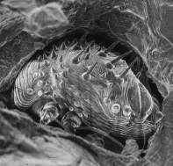

scabies
Sarcoptes scabiei
The condition called crusted scabies, where millions of mites may be present is related to immune deficiency (old age, transplant patients, HIV/AIDS patients).
crusted scabies

Slide 33


ccc
Pneumocoptes penrosei (Pneumocoptidae)
Yunkeracarus (Gastronyssidae)
Three families of mammal associated mites are endopararasitic. Pneumocoptidae live in the lungs of rodents, while Gastronyssidae live in the nasal passages of bats and rodents and in eye orbits and stomach of fruit bats.

Slide 34

House dust mites Pyroglyphidae (Analgoidea)
shift to a free-living life style
Ecology: Early derivative taxa
are parasites of birds, e.g.
Onychalges species live on feathers
and some undescribed taxa live in
superficial skin layers.
.
Onychalges pachyspathus
(female)

Slide 35


House dust mites Pyroglyphidae (Analgoidea)
shift to a free-living life style
Several pyroglyphid mites are free-living occurring largely in bird nests. Some species shifted to domestic habitats (house dust mites). Free-living pyroglyphids were long considered as an early derivative lineage of Psoroptidia solely on ecological basis. We will show below, that this is a derived group that secondarily have lost parasitic mode of life.
.
Dermatophagoides farinae (female)
Dermatophagoides evansi (male)

Slide 36


House dust mites Pyroglyphidae (Analgoidea)
shift to a free-living life style
Pyroglyphus (female)
Tachornithoglyphus tachornis (heteromorphic male)

Slide 37
Where pyroglyphids come from?
There are 62 hypotheses based on morphological, immunological, or molecular evidence
These hypotheses can be classified to two groups: HDM are related to (1) free-living Astigmata or (2) parasitic Astigmata.
pyroglyphids ?
2,300 spp
3,800 spp
free-living 1*
free-living 2*
parasitic (Psoroptidia)
Astigmata (6,100 spp)

Slide 38
Where pyroglyphids come from?
Conflict with ecology
If HDMs are related to free-living lineages then their free-living lifestyle is an ancestral feature.
If they originated within parasitic lineages then this may imply that HDM devolved parasitism and become free-living secondarily. This is a violation of Dollo law!
pyroglyphids ?
2,300 spp
3,800 spp
free-living 1*
free-living 2*
parasitic (Psoroptidia)
Astigmata (6,100 spp)

Slide 39
Where pyroglyphids come from?
Conflict with ecology
The latter hypothesis represents the most intriguing question – can permanent parasites return to a free-living state over evolutionary time and, thus, escape the fate of being evolutionary ‘dead ends’ in violation of Dollo’s law? The most recent treatment dubbed this hypothesis as ‘impossible’.
2,300 spp
3,800 spp
free-living 1*
free-living 2*
parasitic (Psoroptidia)
pyroglyphids
Astigmata (6,100 spp)

Slide 40
Dollo’s law
“An organism never returns exactly to a former state, even if it finds itself placed in conditions of existence identical to those in which it has previously lived.”
Louis Dollo (1893)
“Irreversible loss of single complex characters”
Muller, 1930

Slide 41
Dollo law (parasitological corollary)
“Dollo’s law is the predominant paradigm in parasitology, where a move from a free-living state to parasitism is considered a unidirectional pathway or ‘one-way trip’ because organisms lose the structures required to return to the free-living state”
Cruickshank & Paterson (2006)
free-living = “simple” state
parasitic = “complex” state

Slide 42
Dollo law (parasitological corollary)
Irreversibility of parasitism is also suggested by genomic data. Parasites live in relatively simple and predictable environment and loose genes responsible for interaction with complex environment. It is very hard to imagine that there is a mechanism allowing to quickly restore these genes.
Psoroptidian Astigmata are perfect models to test the parasitological definition of Dollo law because they are “permanent” parasites. They do not have a free-living dispersal stage and spend they entire life cycle on the host body.

Slide 43
Dataset
five nuclear genes: 18S, 28S rDNA, EF1-α, SRP54, and HSP70 (8,942 nt, after removing introns and unalignable regions)
No missing data
rDNA aligned based on secondary structure
4) 315 terminal taxa, including all outgroups ever proposed for house dust mites.
5) Phylogenetic tree inferred with Maximum Likelihood and Bayesian and frameworks.
6) Species tree estimated using the coalescent-based species tree method in *BEAST v1.7.3 for a subset of taxa focusing on HDMs and relatives

Slide 44


Slide 45
Tests for ‘devolution’ of parasitism.
evaluated the 62 hypotheses of alternative placement of house dust mites using bootstrap replicates generated from site-wise log-likelihoods calculated for each hypothesis in Consel 1.20 (Shimodaira 2002);
conducted an ancestral character state reconstruction to determine the ancestral ecology of house dust mites in BayesTraits (Pagel et al. 2004) using, separately, maximum likelihood parametric bootstrap trees and Bayesian stationary trees to account for phylogenetic uncertainty;
tested for irreversible evolution of parasitism in a recently developed framework (Goldberg and Igic 2008) comparing unconstrained models with those constrained for irreversible evolution, while accounting for speciation, extinction, and character state transition rates in DiversiTree (FitzJohn 2010).

Slide 46
Testing phylogenetic hypotheses in Consel v 1.2
Consel calculates p-values for the AU and other types of statistics using bootstrap replicates generated from site-wise log-likelihoods with the RELL resampling method – a fast and accurate approximation technique (Shimodaira 2001).
We generated a matrix of site-wise log-likelihoods in Garli using constraints corresponding to each of the 62 hypotheses on phylogenetic placement of pyroglyphids.
Significant p-values (p>0.05) were then used to evaluate the 62 previously proposed hypotheses of placement of house dust mites.

Slide 47

Testing phylogenetic hypotheses in Consel

Slide 48
Testing phylogenetic hypotheses in Consel v 1.2
All hypotheses involving close relationships of the storage and dust mites were statistically rejected by our Consel analyses.
The five hypotheses that cannot be rejected by our analyses (p>0.05) suggest a parasitic sister-group of the dust mites. These hypotheses indicate the possibility that HDM had a parasitic ancestor evolved the free-living style secondarily.

Slide 50
Reconstructing ancestral ecology
(estimating probability for parasitic HDMs)
1) Ancestral character state reconstruction was done in maximum likelihood and Bayesian frameworks in BayesTraits (Pagel et al. 2004).
2) To account for uncertainty in our phylogenetic inferences, bootstrap trees (Maximum Likelihood) and post burn-in trees sampled from the posterior probability distribution (Bayesian analysis) were used.
3) Because the variable describing parasitism in our system has three levels (free-living, parasitic as deutonymph, permanently parasitic, see below), reconstructions were performed under a six-rate model (transition rates between all character states are different).
4) The single-rate model (all transition rates are equal) was also evaluated to see if it better fits the data. Bayesian analyses were run under reversible jump Markov chain Monte Carlo, where models are visited in proportion to their posterior probabilities.

Slide 51
Character state matrix
(mk3 model)
We obtained a matrix having four sates and 12 character transition rates
Free-Living
FL(1)
q₁₂
q₁₃
q₂₁
q₃₁
q₃₂
PD (2)
Par (3)
Parasitic Deutonymphs
(other stages free-living)
q₂₃
Parasites (full time)
3 states, 6-state transition rates
q₁₂ = transition rate from state 1 -> 2

Slide 52

Reconstructing ancestral ecology
(estimating probability for parasitic HDMs)

Slide 54
Testing for irreversibility of parasitism
(corollary of Dollo’s law)
To reject irreversible evolution (Dollo’s low), one need to also take into account speciation rates. The importance of estimating diversification rates can be demonstrated by the following example. If diversification of free-living mites (state A) is greater than that of parasitic mites (state B), then the B-to-A back transition rate would be overestimated by simple mk models leading to an incorrect rejection of irreversible evolution.
If, however, diversification is independent from state A, then mk-models can be used to assess unidirectional evolution.
For these reasons, we conducted different analyses estimating state transitions rates only (mk) or both transition and diversification rates (BiSSE, MuSSE).
Irreversible evolution is rejected when all tests prefer unconstrained models over models constrained for irreversible evolution with AIC differences of more than 10 (Burnham and Anderson 2004).

Slide 55
mk3 model with speciation (λ) and extinction rates (μ) (MuSSe)
Free-Living
We obtained a matrix having four sates and 12 character transition rates
λ₁
FL(1)
Irreversible evolution:
q₂₁ & q₃₁ = 0
q₁₂
q₁₃
μ₁
q₂₁
q₃₁
λ₂
q₃₂
PD (2)
Par (3)
λ₃
q₂₃
μ₂
μ₃
Parasitic Deutonymphs
(other stages free-living)
Parasites (full time)
3 states, 6-state transition rates
q₁₂ = transition rate from state 1 -> 2

Slide 56
Testing for irreversibility of parasitism
(corollary of Dollo’s law)
1) We tested the hypothesis of irreversibility of parasitism (ecological interpretation of Dollo’s law) using a recently developed framework (Goldberg and Igic 2008) in DiversiTree
2) Two models were used: Binary State Speciation and Extinction (BISSE) and Multiple State Speciation and Extinction (MuSSE).
3) These models implement Markov models of character state evolution (mk2 - 2 states, mk3 - 3 states)
4) three possible schemes of character state coding: (i) three-state coding (free-living, parasitic as deutonymphs, and parasitic in all stages) and two approaches of binary coding (ii-iii) where the 'parasitic as deutonymphs' state was assigned to either 'free-living' or to 'parasitic', respectively).
5) Models corresponding to the three coding schemes were constrained to conform to the assumptions of irreversible evolution (root is fixed to the free-living state; back transition rates are set to zero) and then compared to unconstrained models using the Akaike Information Criterion (AIC).

Slide 57
Testing for irreversibility of parasitism
(corollary of Dollo’s law)
unconstrained model
model constrained for irreversibility of parasitism

Slide 58
Testing for irreversibility of parasitism
(corollary of Dollo’s law)
Our analyses indicate that unconstrained models perform substantially better than models constrained for unidirectional evolution (the root is fixed to the free-living state, the transition rate of parasitism-to-free-living state is set to zero) in all pairwise comparisons representing different coding strategies for the variable ‘parasitism’.
The full-rate models (Table 2, rows 3, 4, 9, 10, 15, 16) were preferred over the single-rate models (rows 1, 2, 7, 8, 13, 14), justifying the use of the former over the transition-only models (Mk). In these best, unconstrained, full-rate models, speciation rates were inferred to be much higher, and the corresponding extinction rates were estimated to be much lower for the parasitic state than the free-living state (Table 2, rows 3, 9, 15).
In contrast, under the assumptions of irreversible evolution, the increase in diversification rates should be associated with the free-living state. No differences in results were observed in three separate analyses utilizing different coding strategies

Slide 59
Testing for irreversibility of parasitism
(corollary of Dollo’s law)
Because unconstrained, full-rate models accounting for diversification and character state transition were preferred over models constrained for irreversible evolution (ΔAIC 33.4, 17.8, 22.1 for the three coding strategies; Table 2), and the increase of diversification rates is associated with the parasitic state rather than the free-living state, irreversible evolution is rejected in this system.

Slide 60
How pyroglyphid become free-living?
Nests of birds, mammals or both are the principal habitat of all modern free-living pyroglyphid species (a few exceptions probably involve accidental records).
We propose that a combination of several characteristics of their parasitic ancestors played an important role in abandoning permanent parasitism:
1) tolerance of low humidity
2) development of powerful digestive enzymes allowing feeding on skin and keratinous materials
3) low host specificity with frequent shifts to unrelated hosts.

Slide 61
How pyroglyphid become free-living?
As compared to non-pyroglyphid free-living mites, efficient water balance mechanisms have appeared within parasitic lineages of Psoroptidia (Gaede and Knülle 1987) in response to living in specific regions of the host body (e.g., skin surface, flight feathers) and feeding on a dry, fat-rich diet (keratinaceous materials and lipids of the skin, sebaceous or uropygial gland secretions).
The specific diet of the mites and the need to evade the host immune response probably promoted development of powerful, specialized enzymes, such as cysteine protease (group 1 allergen) (Kato et al. 2005). These features, occurring in almost all parasitic mites, were potentially important precursors enabling mite populations to thrive in host nests despite low humidity and scarce, low quality food resources, largely consisting of shed skin and feathers.

Slide 62
How pyroglyphid become free-living?
As evidenced by frequent ancestral shifts to unrelated host lineages, selection in early pyroglyphids appears to have favored an unspecialized morphology (such as the absence of elaborate leg and gnathosomal modifications specialized for attachment to specific places on the hosts, Fig. 2), which probably enabled the switch from permanent parasitism to a completely or partially free-living condition.

Slide 64
How pyroglyphid become free-living?
This transition might have occurred through an intermediate state, with mites living both in the nest and on the body of the host, utilizing the host chiefly for dispersal. This intermediate state can still be seen in several Dermatophagoides species, such as D. evansi (pers. obs.) and D. pteronyssinus. With the advent of human civilization, nest-inhabiting pyroglyphids could have shifted to human dwellings from the nests of synanthropic birds or rodents, where, thanks to potent digestive enzymes and other immunogenic molecules, they became a major source of allergies.

Slide 65
Additional evidence to support our hypothesis
The ancestrally parasitic lifestyle of the dust mites is a very plausible explanation for the ability of present day dust mites to modulate host immunity and downgrade host immunological response in laboratory settings (Arlian and Morgan 2011).
One would expect this feature to be present only in true parasites, having a direct contact with the host immune system

