Slide 1
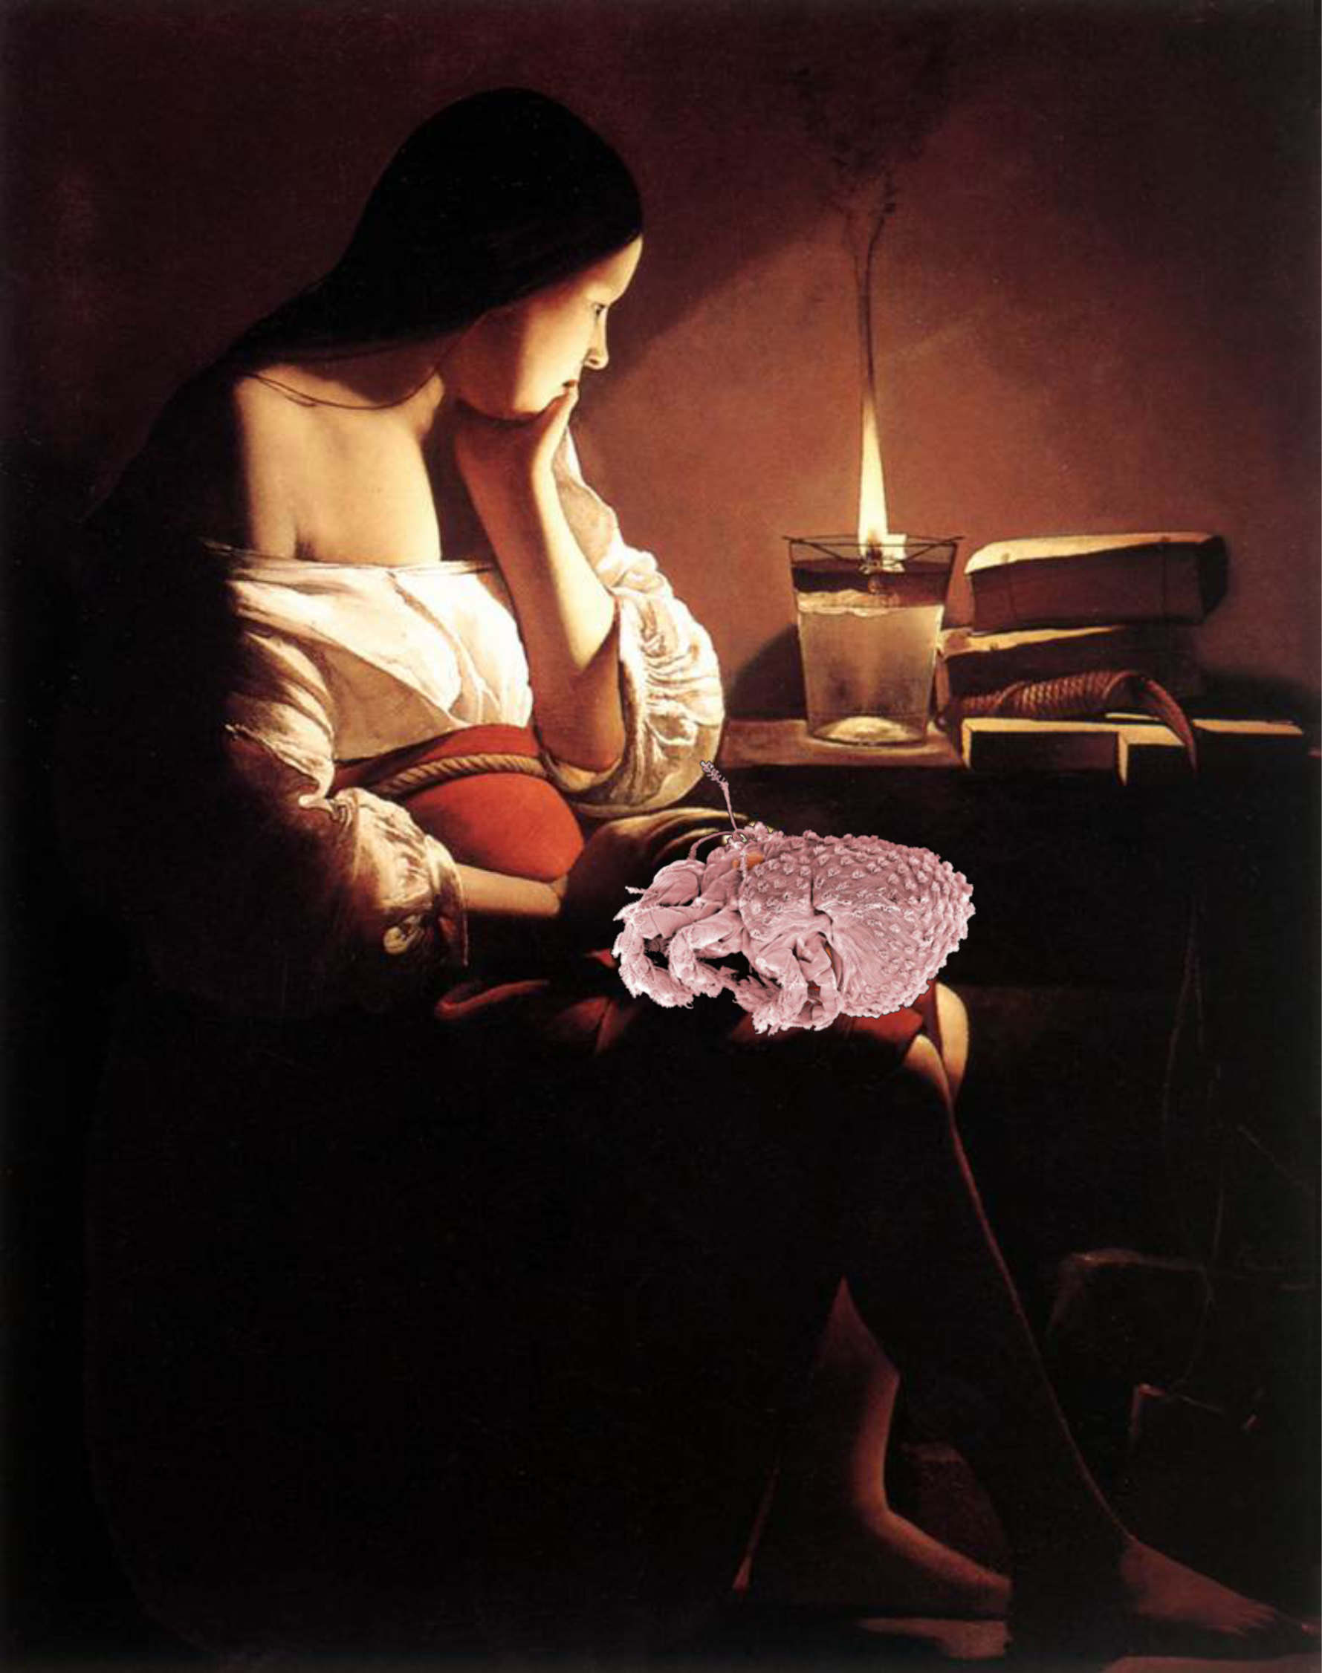
Does deep soil habitat influence the maintenance of ancient asexual lineages in acariform mites?
Pavel Klimov¹, Barry OConnor¹, Almir Pepato², Samuel Bolton³, Hans Klompen³, Andrey Tolstikov⁴
¹ University of Michigan, ² Federal University of Minas Gerais (Brazil),
³ Ohio State University (USA), ⁴ Tyumen State University (Russia)
2:00-2:20 pm Nov 10, 2013 Acarology in Molecular Era. ESA 61st Annual Meeting, Austin, Texas

Slide 2
Cost of Sex
recombination (breakup of favorable combinations of alleles);
fertilization (density dependence and risk to disease/predator exposure);
cost of producing males and ‘genome dilution’ (a sexual parent transmits only 50% of its genes to the offspring);
costs of sexual selection
transposable elements (parasitic DNA)
etc … etc …
Despite those costs, sex prevails in metazoan lineages, and asexuals are rare. Why? There is no simple answer. Perhaps it is a combination of genetic and ecological forces.

Slide 3
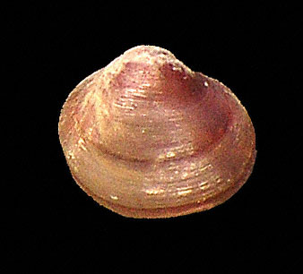
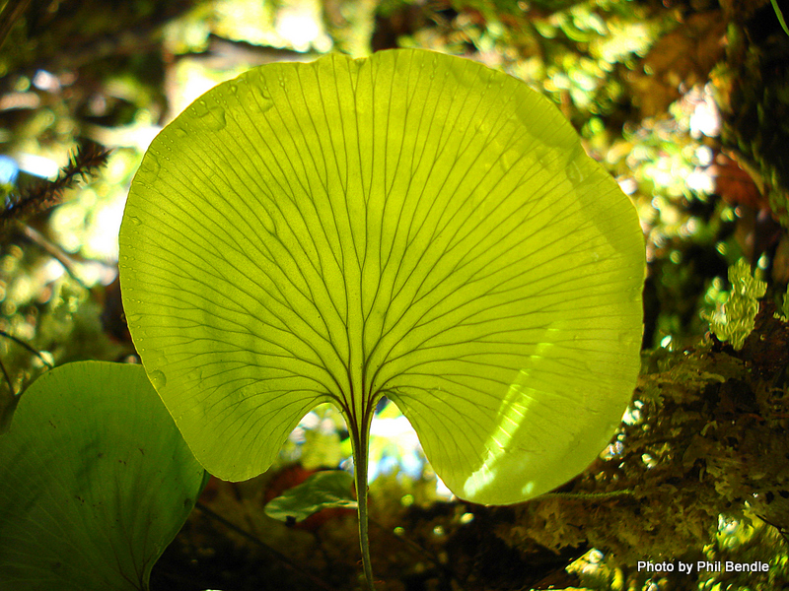
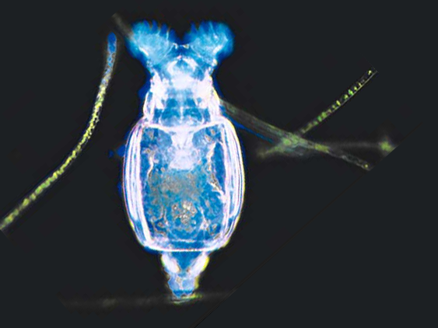
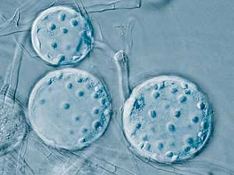
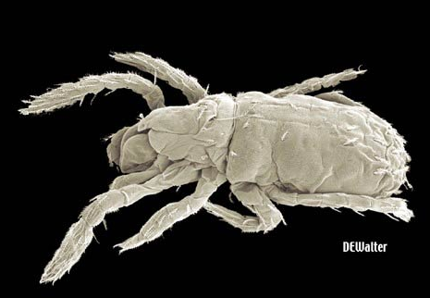
‘Ancient’ asexual lineages may provide clues for potential factors favoring the maintenance of sexual reproduction
Lasaea
5.5-7.6 Mya
Trichomanes
10 Mya
Bdelloid rotifers
40 Mya
Glomus (Glomales)
400 Mya
Alicorhagia 410 Mya

Slide 4
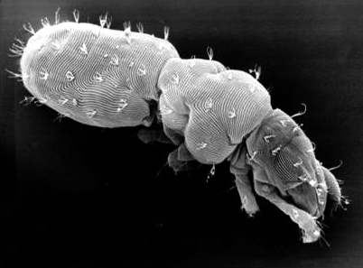
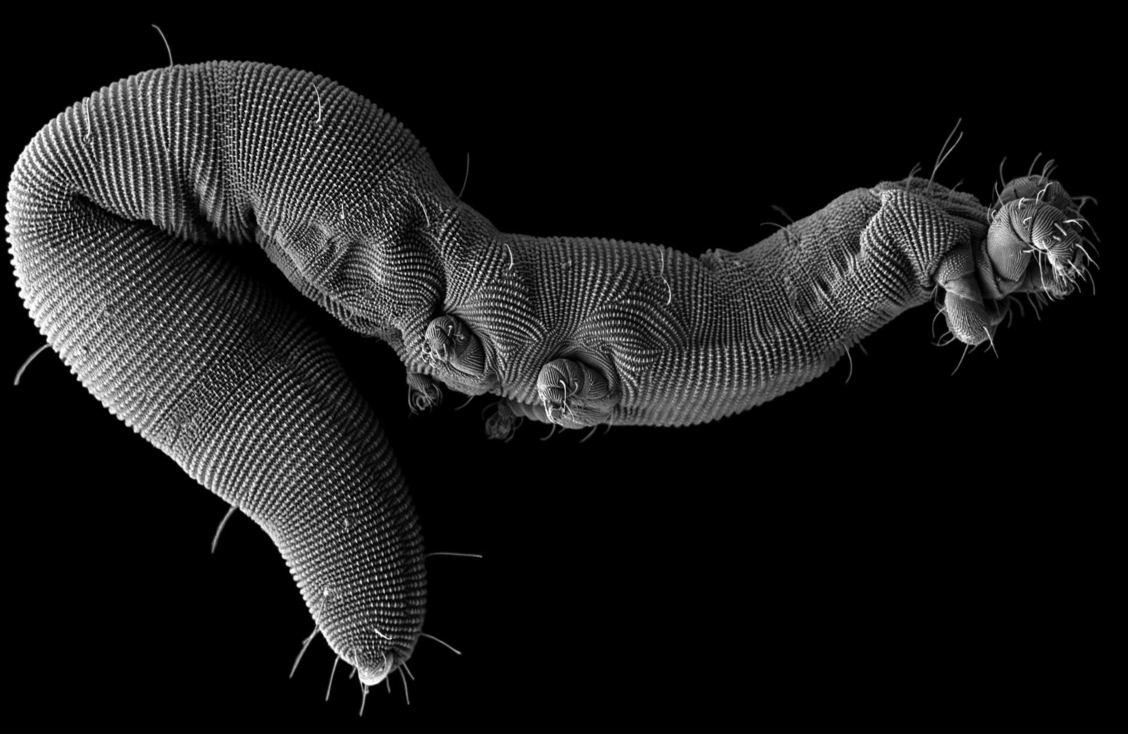
Endeostigmata are the most ‘ancient’ asexual eukaryotes
Endeostigmata are usually microscopic, almost transparent, mites living in deep soil, sand and forest litter.
They are known from the Devonian (~410 mya). Some living endeostigs have not changed morphologically too much since the Devonian and are asexual. Many of them live in deep soil 30 cm to more than 1 m. No sampling were attempted at a greater depth.
Stigmalychus (deep soil)
410 Mya
Alicorhagia
410 Mya
(deep and upper soil)
Nematalycidae ?410 Mya

Slide 5
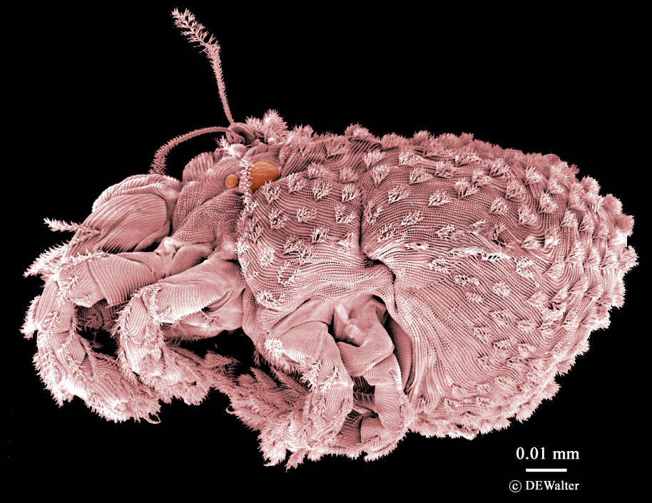
‘Endeostigmata’
Species of Nanorchestes can live in both deep soil and upper soil. They are also common in the arctic and Antarctica.
Nanorchestes
(deep and upper soil, sexual)

Slide 6
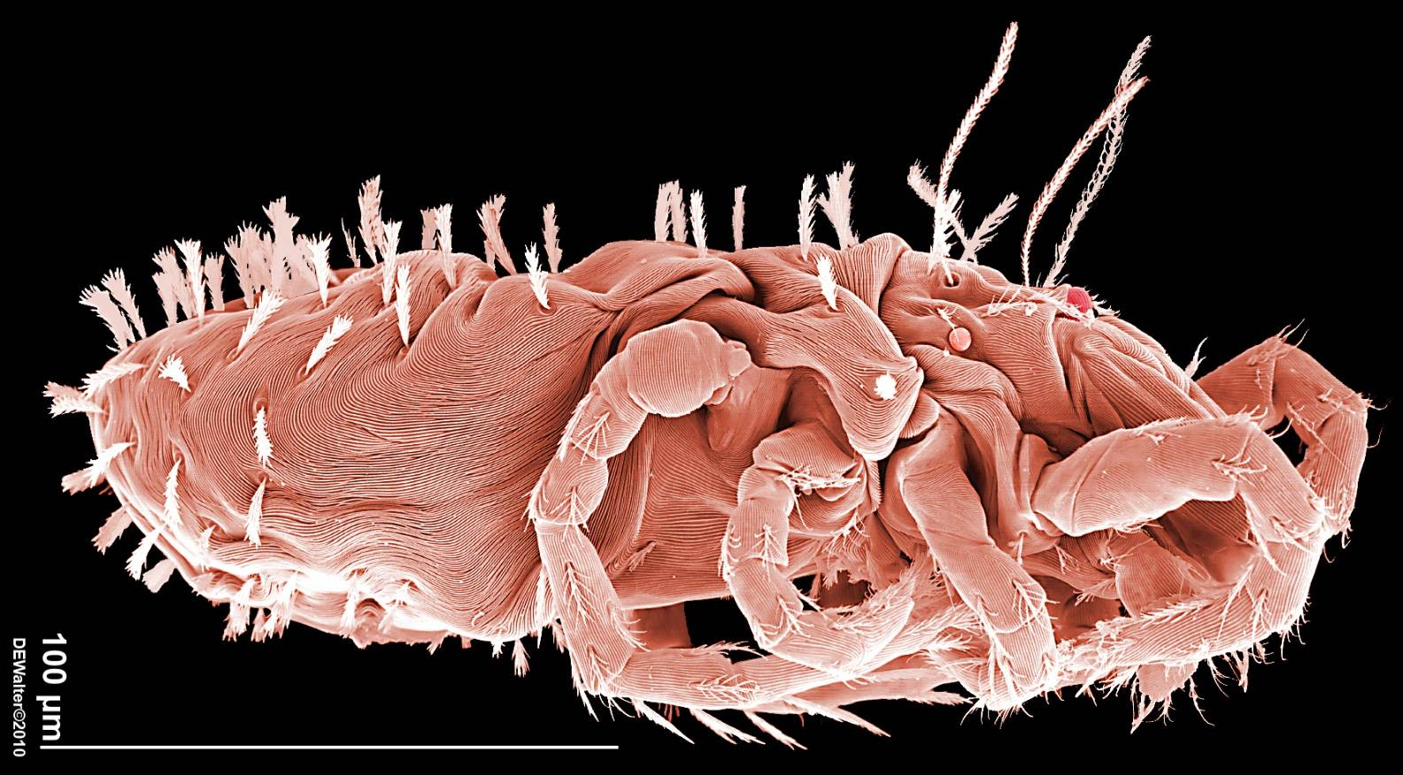
‘Endeostigmata’
Species of Speleorchestes are very common and abundant in very dry moss or very dry upper soil layers. One undescribed species has been collected in deep soil
Speleorchestes
(upper soil, rarely in deep soil, sexual)

Slide 7
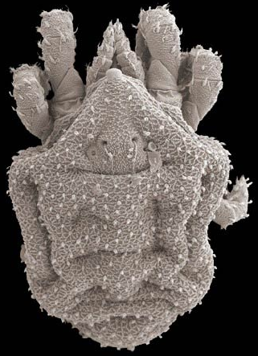
‘Endeostigmata’
Bimichaelia and relatives live in forest litter and moss. One undescribed species is found in deep soil. This lineage is a mixture of sexual and asexual species.
Bimichaelia
(mostly upper soil,
sexual or asexual)

Slide 8
‘Endeostigmata’
Alicorhagia is a predatory mite. Species are very common and very broadly distributed across continents. Exclusively asexual.
Alicorhagia
(deep and upper soil, asexual)

Slide 9
‘Endeostigmata’
Species of Stigmalychus live in deep soil only. Sometimes 2 or 3 species can be collected from the same soil sample. Only asexual taxa are known.
Stigmalychus
(deep soil, asexual)

Slide 10
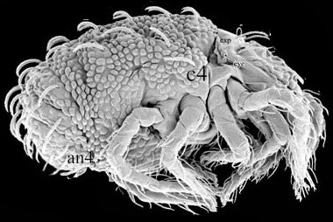
‘Endeostigmata’
Some species display distinct opisthosomal segmentation and were traditionally used as models to reconstruct ancestral acariform segmentation. All species of Terpnacarus are asexual, inhabiting forest litter and moss.
Terpnacarus
(upper soil, asexual)

Slide 11
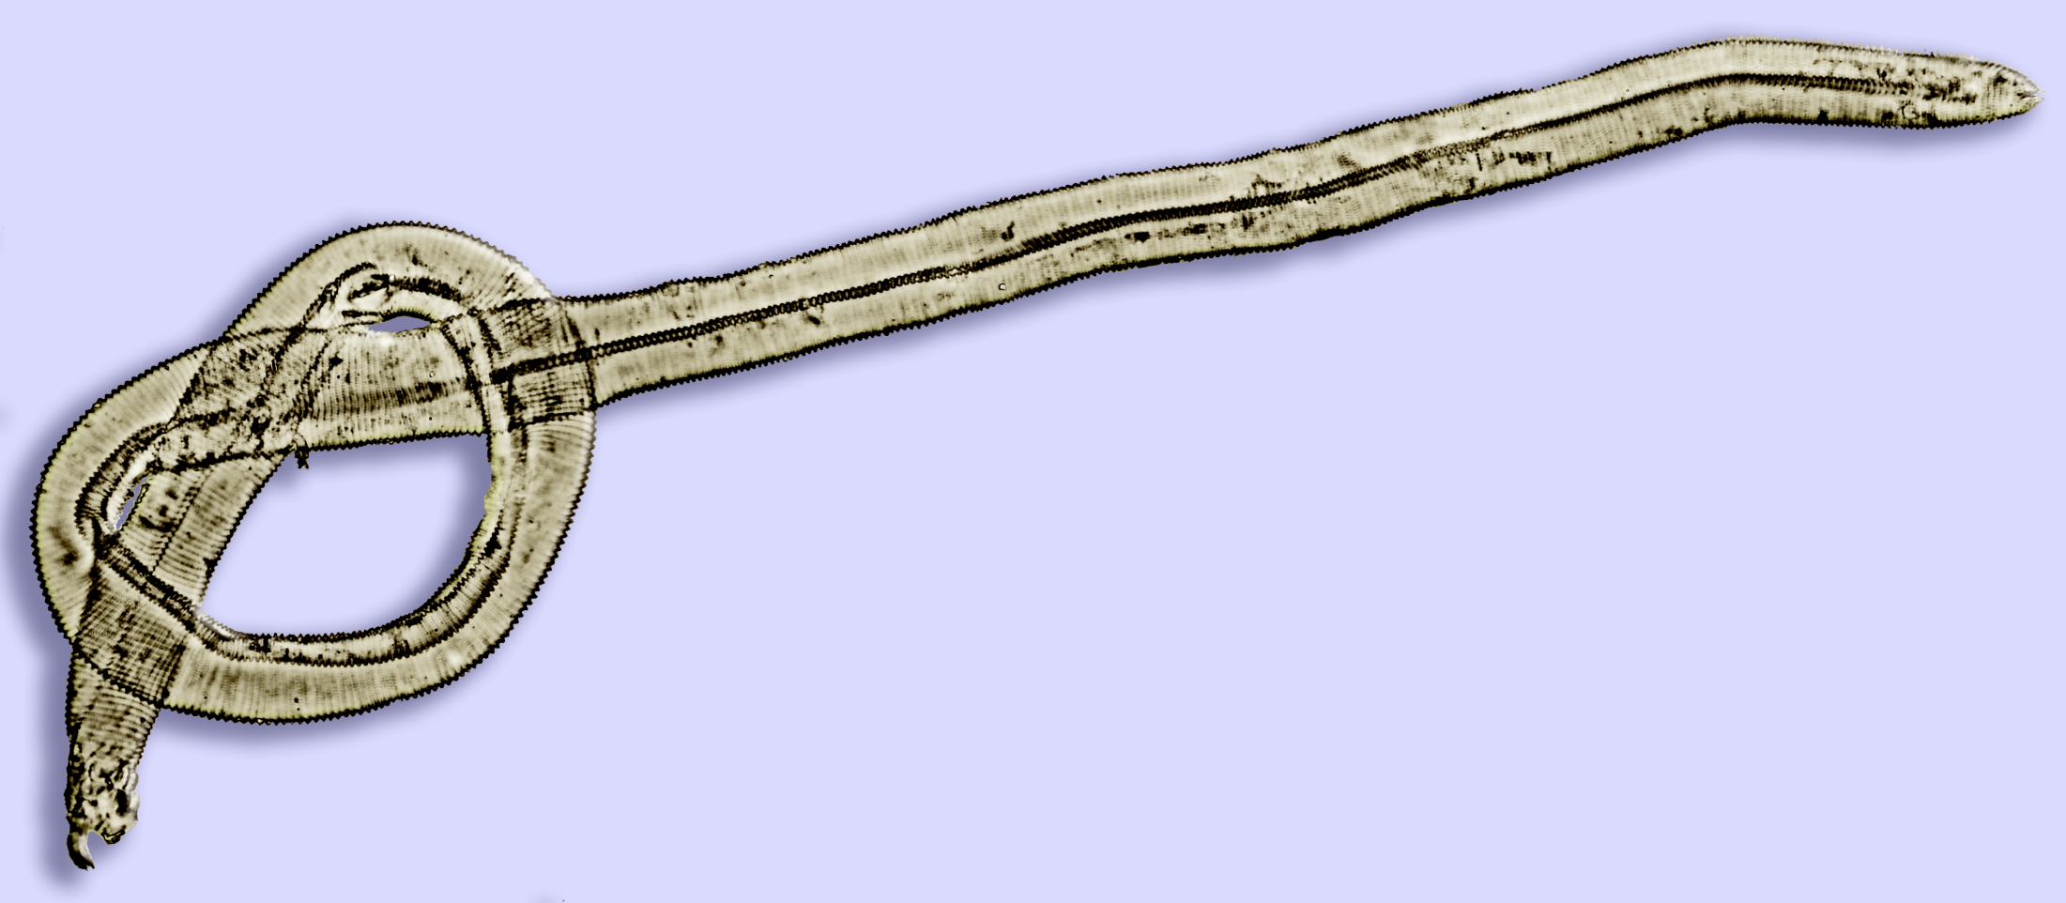
‘Endeostigmata’
‘tail’
Some species, however, are highly modified. For example, Nematalycidae are vermiform giants, reaching 1-2 millimeters in length. This shape is apparently an adaptation for living between sand or soil particles in deep soil. All nematalycids are asexual.
‘head’
Gordialycus
(deep soil, asexual)
gen. n. (in press)
(deep soil, asexual)

Slide 12
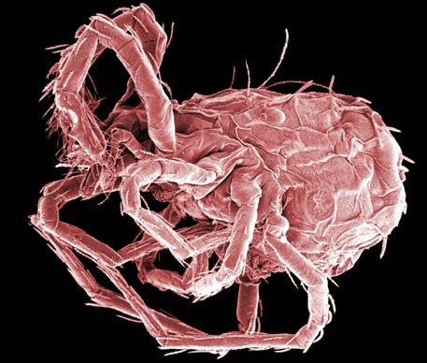
‘Endeostigmata’
Sphaerolichus prefers upper soil. Often very dry areas. It is asexual.
Sphaerolichus
(upper soil, asexual)

Slide 13
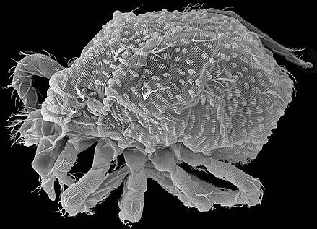
‘Endeostigmata’
Hybalycus
(upper soil, asexual)
Hybalycus lives in upper soil and moss. All species are strictly asexual.

Slide 14
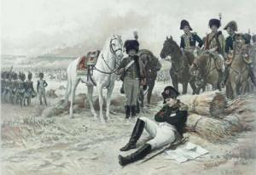
‘Endeostigmata’ gave rise to the modern diversity of acariform mites (42,000+ spp)
fur mites
House dust mites
Sir, our troops are surrounded by Cossacks
Feather mites
Hybaliycus and Sphaerolichus were hypothesized to be more related to Prostigmata. And this is supported by our molecular evidence.
Some other Endeostigmata mentioned above gave rise to another large monophyletic group comprising oribatids and Astigmata.
Thus, all modern diversity of acariform mites were generated from a endeostigmatan mites.
For non-acarologists, I will mention chiggers, house dust mites, sarcoptic mange mites, gall mites, spider mites, etc
Demodectic mites
Eyelash mite
Sarcoptic mange
mite
chorioptic mange mite
chiggers
No, mites did it first
Cheyletid mites
Gall mites
Straw itch mite
Spider mites
Stored product mites
wheat curl mite
False spider mites
winter grain mite
grain mites
oribatid (soil) mites
Cheese mite

Slide 15
We inferred a maximum likelihood tree based on 5 nuclear genes.
On this phylogenetic tree, Endeostigmata occupy basal position in the Acariformes. This is a paraphyletic grade giving rise to the most modern mites belonging to the two large lineages, Trombidiformes and Sarcoptiformes.
Given this tree many asexual lineages live in deep soil and many sexual lineages live in upper soil. Does deep soil favors asexuality and disfavors sexuality?
Maximum likelihood
Five nuclear genes: 18S, 28S rDNA, Ef1α, SRP54, HSP70
Alignment: 6138 nt (6.9% of missing data)
Partitions: rDNA stems, rDNA loops, Ef1α, SRP54, HSP70

Slide 16
Assumptions
Asexuals do better in deep soil because:
Deep soil is a stable and predictable environment => reshuffling alleles provides no advantage when environments are stable. Mass cloning of the most adapted genotype is the best strategy in deep soil.
Food is scarce, population densities (but not size!) are low => (i) finding a mate is difficult; (ii) predators and disease are rare.
In upper soil, asexuals can’t compete with genetically diverse sexuals and go extinct more frequently.
NB. These assumptions may also apply to some (but not all) upper soil habitats, where the environment is homogeneous in time and space. For example, higher altitudes or latitudes.

Slide 17
Data
Lineage | US | UA | DS | DA | total
Chelicerata | 110920 | 1034 | 95 | 378 | 112427
Acari | 53435 | 1034 | 95 | 378 | 54942
Acariformes | 41152 | 970 | 95 | 368 | 42585
Endeostigmata | 83 | 26 | 14 | 74 | 197
Let take a look at the absolute numbers of asexual and sexual lineages across two habitats in Chelicerates.
Sexuals are more frequent at upper soil, while they are very rare in deep soil. Oddly, asexual species are prevalent in upper soil in all taxa, except for Endeostigmata.
U/D=Upper/deep soil soil; S/A=Sexual/Asexual
Species richness (log10)

Slide 18
Hypotheses
H₁ In sexuals, diversification (speciation minus extinction) rates are lower in deep soil than in upper soil
H₂ In asexuals, diversification rates are higher in deep soil than in upper soil.
Based on our assumptions and empirical data, we propose a hypotheses that includes a subset of two separate subhypotheses.
NB. ‘Deep soil ≠ sexuality’ is not the same as ‘Deep soil = asexuality’!

Slide 19
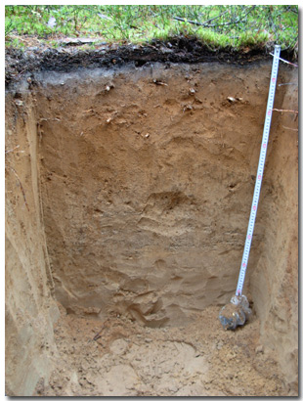
Hypothesis testing
We have two traits with 2 states each:
1. Environment:
U=Upper soil (and all other habitas)
D=Deep soil*
2. Sexuality:
S=Sexual
A=Asexual
Hence a four-state matrix can be constucted,
allowing for transitions between any state
Upper soil
Deep Soil
* mineral regolith (very low organic content). Typically below 30 cm

Slide 20
Character state matrix
We obtained a matrix having four sates and 12 character transition rates
Soil
sf₂
Sexuality
q₁₂
q₂₁
Upper
US(1)
UA(2)
Sexual
q₁₄
q₂₃
q₁₃
q₃₁
q₂₄
q₄₂
q₃₂
q₄₁
Deep
q₄₃
Asexual
DS(3)
DA(4)
q₃₄
sf₄
4 states, 12 state transition rates
q₁₂ = transition rate from state 1 -> 2

Slide 21
Model with speciation and extinction rates (λ and μ)
Then we will add speciation rates (lambda) and extinction (mu) rates for each state. This adds 8 more parameters. The result is the full, 20-parameter model.
Soil
Sexuality
q₁₂
λ₁
λ₂
q₂₁
Upper
US(1)
UA(2)
Sexual
μ₁
μ₂
q₁₄
q₂₃
q₁₃
q₃₁
q₂₄
q₄₂
q₃₂
q₄₁
Deep
q₄₃
Asexual
DS(3)
DA(4)
λ₃
q₃₄
λ₄
μ₃
Parameters
μ₄
q₁₂ character state transition rate (state 1 -> 2)
λ₁ speciation rate (species in state 1)
μ₁ extinction rate (species in state 1)

Slide 22
Model (with sampling frequencies)
This is not all! We need to account for incomplete sampling. For the four states we add a vector of sampling frequencies for each state. Incomplete sampling will be explicitly accounted for when the model is fit to the data. The model will be fitted given our phylogenetic tree using maximum likelihood.
Soil
sf₂
Sexuality
sf₁
q₁₂
λ₁
λ₂
q₂₁
Upper
US(1)
UA(2)
Sexual
μ₁
μ₂
q₁₄
q₂₃
q₁₃
q₃₁
q₂₄
q₄₂
q₃₂
q₄₁
Deep
q₄₃
Asexual
DS(3)
DA(4)
λ₃
q₃₄
λ₄
sf₃
sf₄
μ₃
Parameters
μ₄
q₁₂ character state transition rate (state 1 -> 2)
λ₁ speciation rate (species in state 1)
μ₁ extinction rate (species in state 1)
sf₁ sampling frequency for state 1 (=how much data are sampled)

Slide 23
Correcting for uneven sampling
Sampling effort for states 2-4 is almost the same for the Chelicerate and Acariform datasets. It is around or below 0.05. And even lower for state 1. As expected, sampling effort increases for the endeostigmatan dataset and all four states. The values shown on this graph were using as the sampling frequency vector and it is explicitly accounted for in our models.
Sampling frequency for four states
U=Upper soil
D=Deep soil
S=Sexual
A=Asexual
n=96
n=84
n=36

Slide 24
Hypothesis testing
Build a model with all parameters constrained to be the same. This is the null hypothesis (H₀).
Allow some or all parameters of interest to vary. For example, speciation rates in asexuals from upper and deep soil. This is the hypothesis to be tested (H₁). Repeat to obtain (H₂, H₃ …).
Compare H₀ vs H₁ using ANOVA. Record AICs and Chi Square Statistics. Order hypotheses by their AIC weights.
If H₁ provides a statistically better fit than the constrained model (H₀), then our hypothesis is supported.
In theory, to find the ‘best’ model, parameter space should be investigated for all hypotheses (Johnson & Omland 2004). Here we only consider a set of candidate models which make biological sense.
Johnson J.B., Omland K.S. 2004. Model selection in ecology and evolution. Trends Ecol. Evol. 19:101-108.

Slide 25
Model (given the tree)
We first construct a matrix specifying rates of speciation, extinction, and character state transition for each of the states. Then we fit this matrix given our phylogenetic tree using maximum likelihood. The analysis will also account for incomplete sampling for each state. The result is our basic full, 20 parameter model.
Soil
sf₂
Sexuality
sf₁
q₁₂
λ₁
λ₂
q₂₁
Upper
US(1)
UA(2)
Sexual
μ₁
μ₂
q₁₄
q₂₃
q₁₃
q₃₁
q₂₄
q₄₂
q₃₂
q₄₁
Deep
q₄₃
Asexual
DS(3)
DA(4)
λ₃
q₃₄
λ₄
sf₃
sf₄
μ₃
Parameters
μ₄
q₁₂ character state transition rate (state 1 -> 2)
λ₁ speciation rate (species in state 1)
μ₁ extinction rate (species in state 1)
sf₁ sampling frequency for state 1 (=how much data are sampled)

Slide 26
Does deep soil affect sexuality or asexuality in Endeostigmata?
I will start with the model fitted for the endeostigmatid subsample. This group includes 197 described and undescribed species. Of them 36 have been sampled.
The model makes overall sense. Upper soil is a diversification hotspot, with asexuals in the upper soil tending to become sexual (the q21 rate).
Being sexual and living in deep soil is a sink -- Sexual mites are migrating to deep soil were they gradually become extinct. This is consistent to the prediction of our hypothesis.
Deep soil is a source generating diversity of asexual mites as evidenced by their high diversification rates. These mites migrate to upper soil then diversify or become sexual. Alternatively the transition occurs directly: deep soil asexuals became sexual living at the upper soil.
Comparison of this scenario with the fully constrained model showed that it is, unfortunately, not significant (p=0.660). Subset hypotheses, M1 and M2, were also non-significant.
This analysis uses 20 parameters to fit the data on only 36 species. Clearly, a greater sampling is needed here to confirm this scenario.
Hence we will focus on a larger dataset.
Soil
M1
[<-diversification hotspots->]
M2
Sexuality
λ₁
10.3
5.0
λ₂
q₂₁=3.1
Upper
US(1)
UA(2)
Sexual
μ₁=6.2
[source2]
μ₂=0
q₄₁=0.2
q₁₃=1.3
q₄₂=0.8
Deep
Asexual
DS(3)
DA(4)
λ₃
λ₄
7
[source1]
μ₃=3.4
[sink]
μ₄=2.9
λ₁, λ₃, μ₁, μ₃, q₁₃, q₃₁ variable
λ₂ , λ₄, μ₂, μ₄, q₂₄, q₄₂ variable
Deep soil ≠ sexuality (p=0.148, NS)
Deep soil = asexuality (p=0.875, NS)
n=36, sampling 18.3%, root observed, p=0.660 (NS)

Slide 27
Chelicerate model – low representation
Chelicerate model
Sample size n=96
Sampling effort 0.09% of the observed diversity
Difficulties in convergence/numerical problems when some submodels are constrained
Will use the Acariform model
Sample size n=84
Sampling effort 0.20% of the observed diversity
For the previous model sampling effort was high but the sample size was very low, so no significant parameter estimates could be obtained. If the full model representing all chelicerates is considered, then sampling effort reduces to only 0.09% while sample size increases only 3 fold. This model has difficulties in converging of the likelihood function so we will use only the Acariform dataset.

Slide 28
Acariform Model
Soil
Sexuality
q₂₁=0.011
λ₁
1148
67.9
λ₂
This model includes 84 acariform taxa. Sampling effort here is only 0.2% of the observed diversity.
Here sexual lineages living in upper soil speciate faster (on the order of magnitude) than other groups. This is a biodiversity hotspot for acariform mites. However, this group also go extinct faster.
Sexual lineages living in deep soil do not have any tangible speciation rates. This state seems transitory: it has nearly the same chances to either go back to the upper soil or became asexual
This pattern is consistent with our a priori hypothesis.
However, in contrast to our expectations, UPPER soil asexual mites were inferred to have higher speciation rates. They also appear to have diversification rates [=speciation minus extinction] twice as high in comparison of Deep soil asexual mites.
One portion of our model supports our hypothesis but the other is not. Let’s check if these submodels are significant.
q₂₁=5.5
Upper
US(1)
UA(2)
Sexual
μ₁=1144.6
μ₂=56.4
q₁₃=0.02
q₃₁=2.2
q₂₄=0.29
q₄₂=1.03
Deep
Asexual
DS(3)
q₃₄=2.15
DA(4)
λ₄
22.6
μ₄=17.6
n=84, sampling 0.20%, root given, p=6.965e-08***

Slide 29
Does deep soil affect sexuality or asexuality?
(are SM1 and 2 submodels significant?)
Soil
SM1
SM2
Sexuality
q₁₂=0.011
λ₁
1148
67.9
λ₂
q₂₁=5.5
Upper
US(1)
UA(2)
Sexual
The first submodel (SM1) suggesting that diversification of sexual mites in upper soil should be higher is significant by the likelihood ratio test. This is good news for us.
The second submodel (SM2) was also evaluated as significant. This contradicts our prediction, so let look at our data again.
μ₁=1144.6
μ₂=56.4
q₁₃=0.02
q₃₁=2.2
q₂₄=0.29
q₄₂=1.03
Deep
Asexual
DS(3)
q₃₄=2.15
DA(4)
λ₃
λ₄
22.6
μ₃
μ₄=17.6
Deep soil ≠ sexuality (p=0.004**)
Deep soil = asexuality (p=3.415e-09***)
rates for 1 and 3 vary, all other rates same
rates for 2 and 4 vary, all other rates same
n=84, sampling 0.20%, root given, p=6.965e-08***

Slide 30
Sexuals live mostly in upper soil
Asexuals live either in deep soil [mostly Endeostigmata] or upper soil [mostly Oribatida]
there are MANY asexual oribatid mites living in upper soil. The reason for loosing sex in these lineages may be completely different. For example, many lineages inhabiting aquatic or wet habitats lose sex. They have spermatophoric insemination and this does not work well in aquatic or semiaquatic habitats. So living in these habitats may be another factor facilitating maintenance of asexulity. It could be that there are many such factors, which unfortunately, were not accounted for in our model. Hence our model indicates that deep soil is not the ONLY factor favoring asexuality. However, this model showed that deep soil disfavors sexuality, and this relationship is highly significant.
Deep soil disfavors sexuality
but this is not the only factor favoring asexuality

Slide 31
Conclusions
(i) Deep soil disfavors sexuality but
(ii) Deep soil is not the only factor favoring asexuality in Acariform mites.
(iii) Other factors might be responsible for maintenance of asexuality in upper soil.

Slide 32
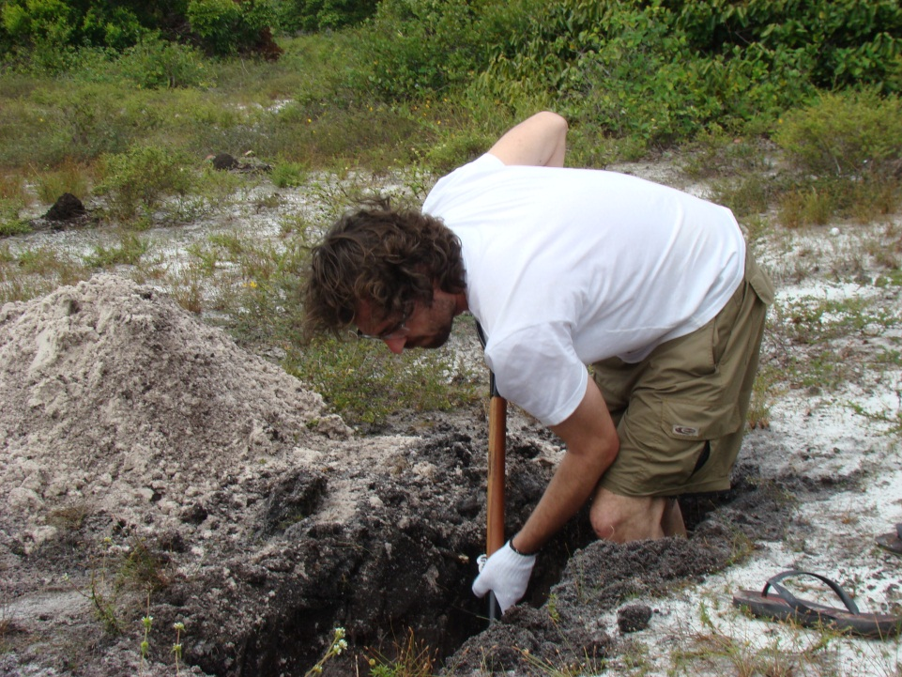
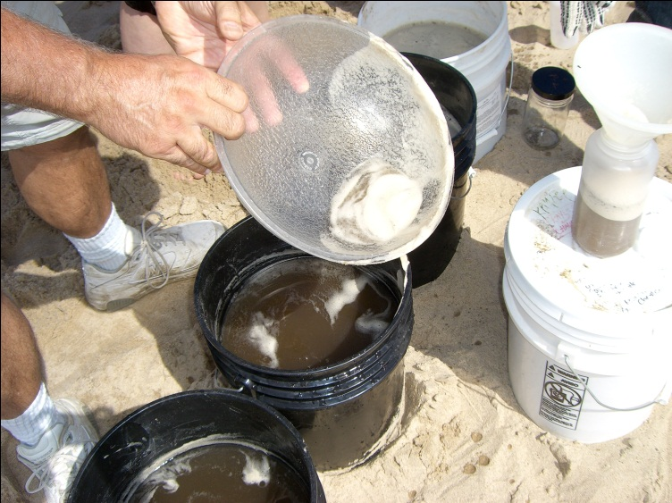
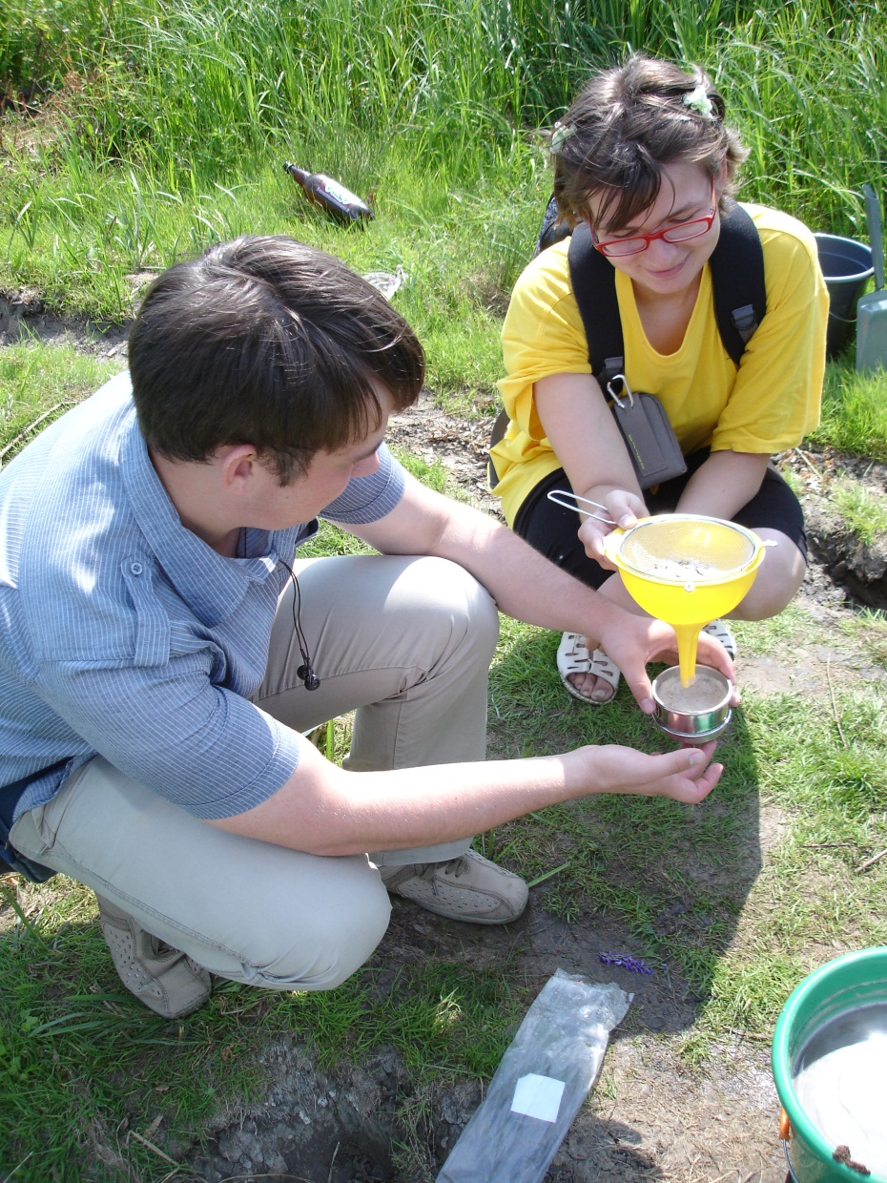
Collecting deep-soil mites
Collecting deep soil mites is a multi-step process
1) excavating a hole and sampling soil at appropriate depth. Usually, it is 10, 30, 60 cm, and 1 m.
2) mixing the samples with water and collecting the foam
3) washing the foam with ethanol and preserving it in absolute ethanol for Kerosene extraction (which is usually done in the lab)
1
Brazil
2
USA
3
Russia

Slide 33
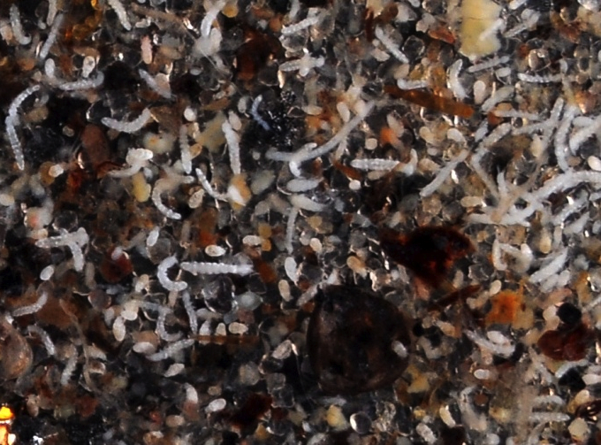
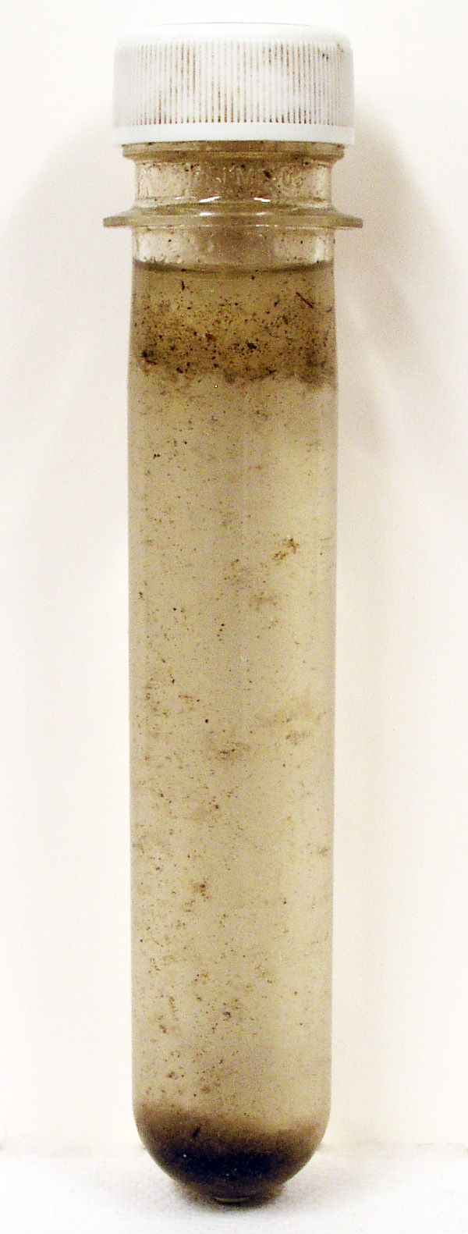
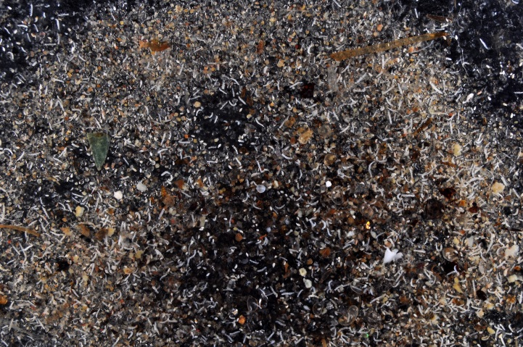
Kerosene extraction
Kerosene
This picture shows the entire sample of mites extracted from a half of a bucket of sandy soil in Michigan using Kerosene/Ethanol extraction.
In short, sample from step 3 is placed in 75% ethanol and then Kerosene is added. The tube is gently inverted, so all chitin-containing particles are gathered in the kerosene supernatant. Then the supernatant is placed on a small-mesh size sieve and washed with 100% ethanol to obtain pure mites.
75% Ethanol

Slide 34

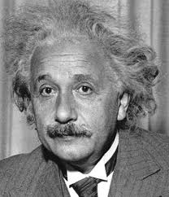

Acknowledgements
OConnor’s lab
Lucy Tran, Huateng Huang, Qixin He (help with analyses)
Roy Norton (discussion)
David Walter (SEM pictures)
Russian Ministry of Science and Education (funding)
Time in the theory of relativity
So many mites, so little time!

Slide 35
not used: Chelicerate Model
Soil
sf₂
Sexuality
sf₁
q₁₂
0.002
λ₁
3107.8
158.7
λ₂
q₂₁
Upper
US(1)
UA(2)
66.3
Sexual
μ₁
μ₂
3103.4
86.6
q₁₃
q₃₁
q₂₄
10.9
q₄₁
0.621
0.014
27.6
Deep
Asexual
DS(3)
DA(4)
λ₃
λ₄
36.9
sf₃
sf₄
μ₃
μ₄
4.69
n=96, sampling 0.09%, root.given, p=2.22e-16***

Slide 36
oldFitting the Model Acariformes, root obs
[div=4.3]
[div=14.5]
Soil
Sexuality
λ₁
906.0
95.8
λ₂
q₂₁=11.3
Upper
US(1)
UA(2)
Sexual
μ₁=901.7
μ₂=81.3
q₄₁=6.1
q₂₄=0.46
q₁₃=0.03
q₃₁=9.6
q₄₂=0.001
Deep
Asexual
DS(3)
DA(4)
λ₄
31.2
[div=7.9]
μ₄=23.2

Slide 37
State distribution
Lineage | US | UA | DS | DA | total
Chelicerata | 98.66 | 0.92 | 0.08 | 0.34 | 112,427
Acari | 97.26 | 1.88 | 0.17 | 0.69 | 54,942
Acariformes | 96.63 | 2.28 | 0.22 | 0.86 | 42,585
Endeostigmata | 42.13 | 13.2 | 7.11 | 37.56 | 197
Species (log10)
96.63%
2.28%
0.86%
U=Upper soil
D=Deep soil
S=Sexual
A=Asexual
0.22%
n=112,427
n=54,942
n=42,585
n=197
n=96

